Slide 1
Postharvest Handling of Fresh Produce
Justin Ballew
Commercial Horticulture Agent
Lexington County
Notes:
In this presentation, we will discuss some of the principles and practices of postharvest handling produce and maintaining produce quality.

Slide 2
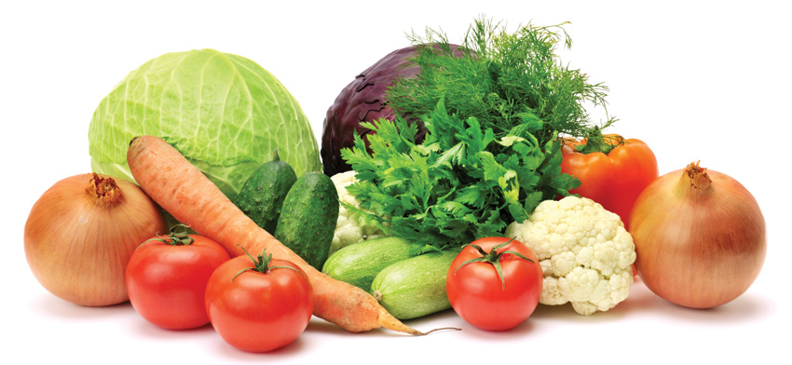
Postharvest Handling
Very little produced is consumed right away
Produce is perishable and is never better than the moment harvested.
Quality never improves, we strive to maintain.
Notes:
Since much of the produce grown in SC is shipped (sometimes long distances), maintaining quality should begin as soon as it’s harvested. Failing to do so may result in having produce rejected by the buyer.

Slide 3
Harvesting
Be gentle with produce.
Abrasion, bruises, smashing
Harvest into clean smooth containers that are easily carried or loaded.
Containers should be sanitized daily.
Stacking can contaminate produce with soil.
Produce is alive, respiration continues after harvest
Young, flowering, and leafy respire rapidly
The higher the respiration rate, the faster the produce will perish.
Temperature is important. More later.
Harvest during coolest times of day
Notes:
Produce continues to respire after it has been harvested, meaning water is lost. Since it’s no longer connected to the vascular system of the plant, water that is lost cannot be replenished. Temperature is an important factor in managing respiration rates.

Slide 4
Notes:
This table shows a number of crops in regard to their storage life. Proper postharvest handling and precooling in most important with crops listed in the top two categories.

Slide 5
Transporting
Small delicate fruits are often damaged by field transport (strawberries, brambles).
Smaller loads taken to storage often is better
Get produce out of field environment (heat) faster.
Loads stored outside should be put in shade.
Shed
Under tree (watch out for birds)
Poorly suspended trucks/trailers can damage by bouncing.
Refrigerated trucks should be cooled ahead of time.
Notes:
Produce can easily be damaged or degraded in the time it take to get that produce from the field to the packing shed. Quality degradation can occur from produce sitting in the sun for too long (remember respiration rates are higher when temperatures are high). Damage can also occur from rough driving or poorly graded roads. Refrigerated trucks may take a while to cool down, so they should be cooled down before produce is loaded.

Slide 6
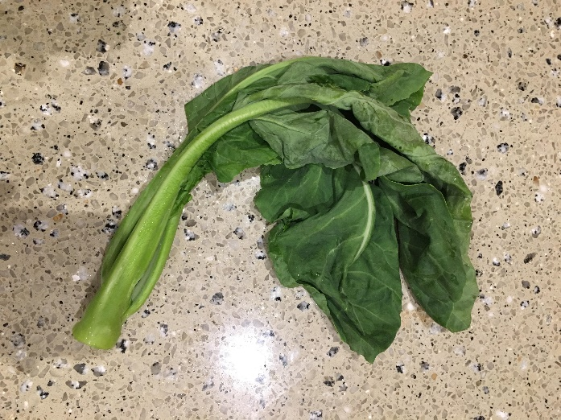
Heat
Temperature is important!
Produce is at the approximate temp. of the air in the field
Respiration produces heat (heat of respiration)
Faster respiration = more heat
Minimized with cooling, heat must be continually removed during storage (cold chain).
Field heat must be removed by pre-cooling.
Notes:
Again, heat is a major enemy to produce quality. Not only are respiration rates higher at higher temperatures, but heat is generated from respiration. Slow down respiration and by pre-cooling produce. Pre-cooling is the process of removing the field heat prior to storage or shipping.

Slide 7
Methods of Pre-Cooling
Air cooling (room cooling)
Hydro-cooling
Vacuum cooling
Ice cooling
Forced-air cooling
Never break the cold chain once cooled!!!
Notes:
The next several slides will show several different methods of pre-cooling and will discuss advantages and disadvantages of each method. Once produce is cooled, it must stay cold until it is consumed! If not it will degrade rapidly.

Slide 8
Air Cooling (Room Cooling)
Simply placing produce in a cold room for a period of time.
Cools very slowly
produce that doesn’t decay rapidly - apples, cabbage, pears, peaches
Air is the least efficient means of cooling
Notes:
Air cooling is very slow and, therefore, is only acceptable for produce with very low respiration rates.

Slide 9
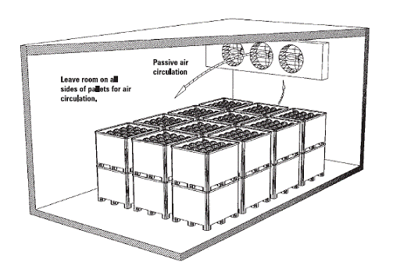
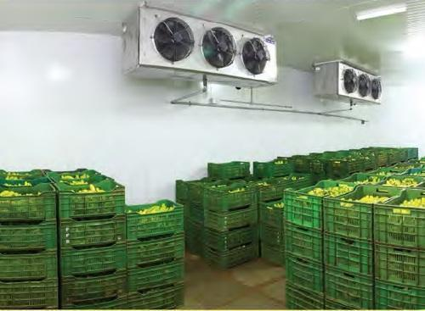
Notes:
The diagram in the top left shows the proper way to stack pallets, bins or boxes in a walk-in cooler for pre-cooling. There must be room around the sides of the containers for air to flow. If containers are stacked tightly with no space in between, it will take a very long time to cool the produce in the center of the stack (days in some cases).

Slide 10
Forced Air Cooling
Very versatile method of cooling
Cool air is drawn through stacked produce
Shortens cooling time significantly over room cooling.
Peppers, tomatoes, cucurbits
Dehydration can occur. Control humidity.
Notes:
Forced air cooling is very common and is a good method of pre-cooling a very wide range of produce. Like room cooling, this takes place in a cool room with fans that draw air through the produce containers. This air movement makes pre-cooling much faster and more efficient than room cooling.

Slide 11
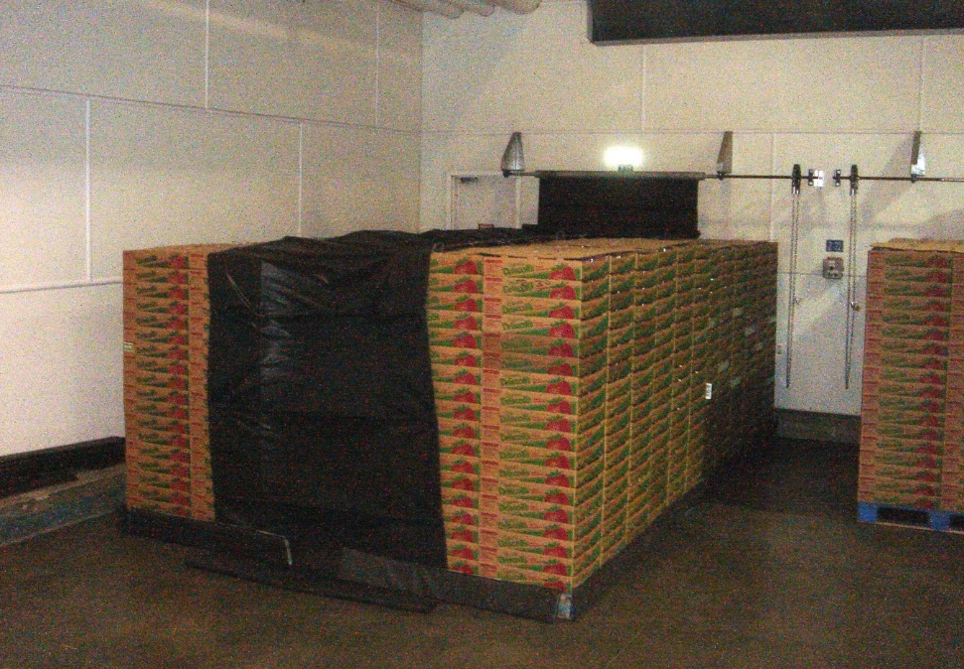
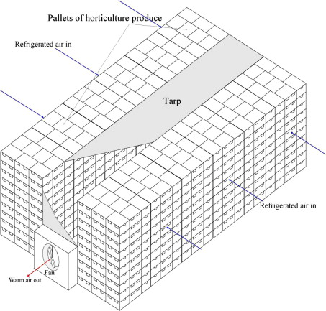
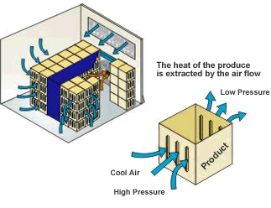
Notes:
The two diagrams at the bottom of the slide show the process of forced air cooling. Produce containers are stacked in rows along either side of a fan. A drape or tarp is used to cover the open space between the rows. This allows the fan to draw air through the produce containers.

Slide 12
Hydro-Cooling
Produce submerged or drenched in near freezing water.
Requires waterproof containers
Produce that decays rapidly - sweet corn, leafy greens, peaches, beans, asparagus
Water sanitation important
Produce like squash, tomato, pepper, tropical fruits cannot be hydrocooled. Water more than 10º cooler than produce can result in imbibition of water.
Notes:
Hydro-cooling is a very rapid means of cooling produce that decays rapidly. It involves using cold water to quickly draw the field heat out of the produce.This is only acceptable for produce that will not imbibe water that is significantly colder than the produce. Regularly monitoring the sanitation of the water is extremely important.

Slide 13
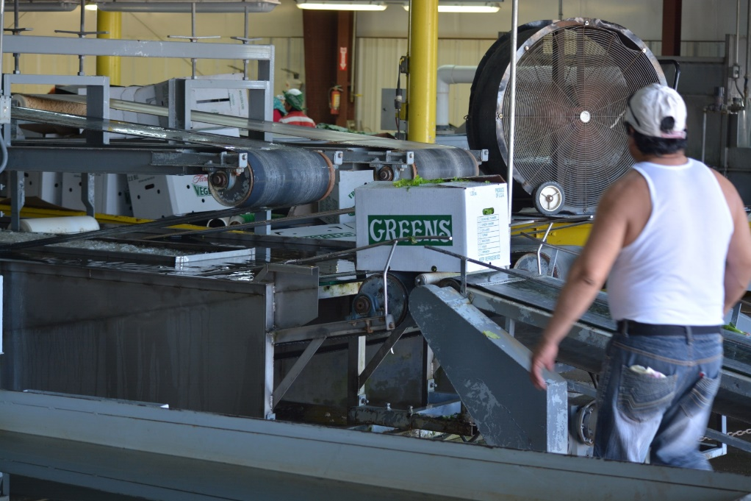
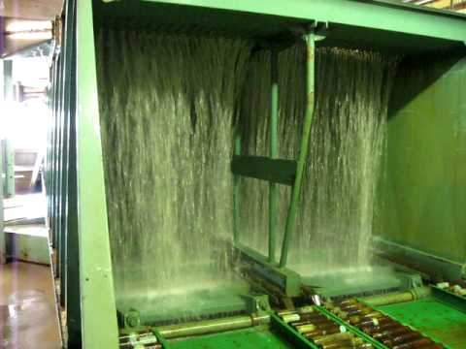
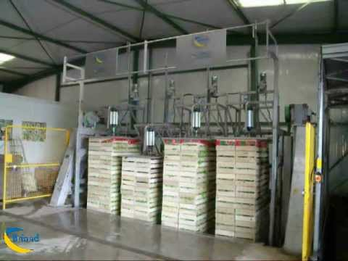
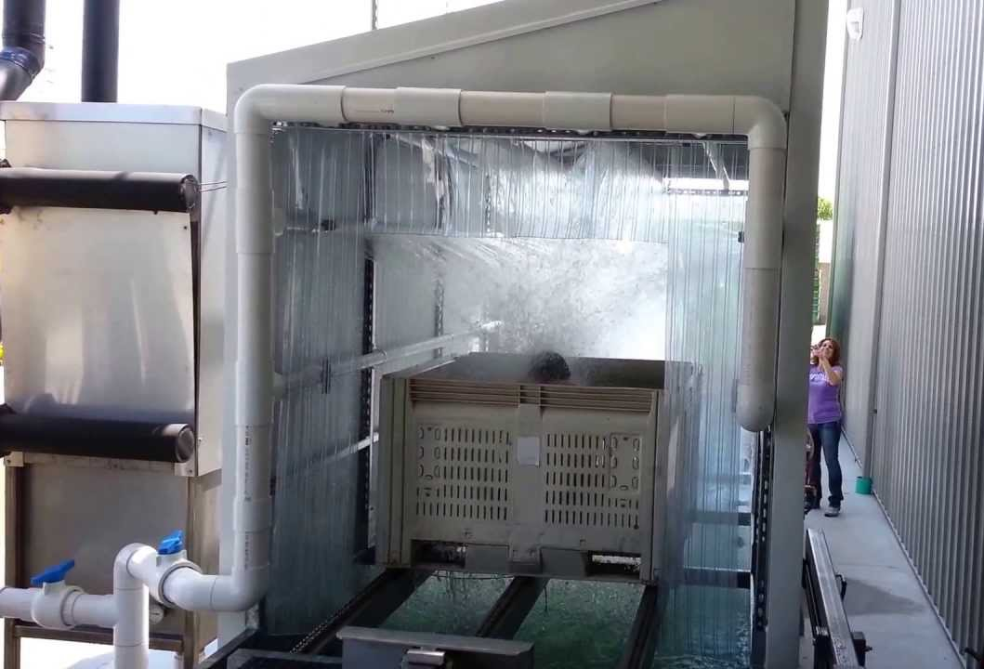
Notes:
These photos show a few different methods of hydro-cooling. The greens hydrocooler at the top left submerges boxes of leafy greens in a cold water bath. The other three photos show systems that drench containers with cold water. Again, it is extremely important to regularly monitor the sanitation of the water. Since the water touches all of the produce, pathogens can spread rapidly if sanitation is poor.

Slide 14
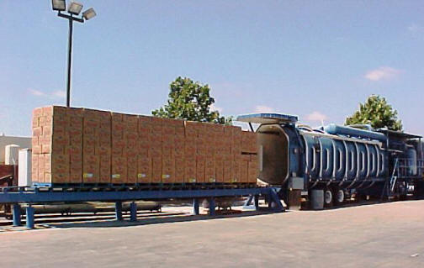
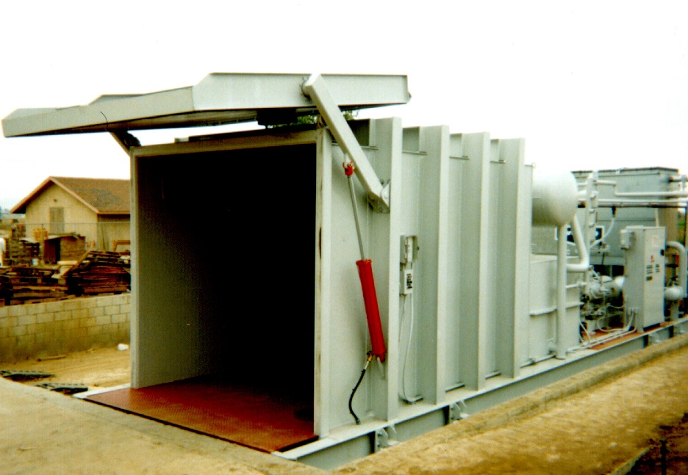
Vacuum Cooling
Cold air is sucked through wet produce to allow rapid evaporation to occur
Leafy greens, broccoli, lettuce
Can dehydrate produce
Notes:
Vacuum cooling is not common in our area. It involves loaded produce into a vacuum sealed container that sucks cold air through the produce containers to rapidly pre cool it. Dehydration can occur.

Slide 15
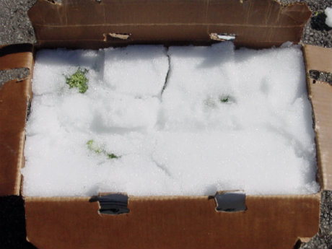
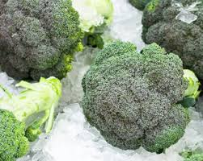
Ice Cooling
Top icing or slurry icing
Top icing better for maintenance than pre-cooling
Slurry icing – shaved ice and water pumped into a packed box.
Requires waterproof containers
Broccoli
Notes:
Ice cooling is used sometimes but is better for keeping produce cold than for pre-cooling. Potable water must be used for the ice.

Slide 16
Comparison of Common Cooling Methods
 | Room/Air | Forced Air | Hydrocool | Water Spray | Ice
Typical Cooling Time (Hours) | 20-100 | 1-10 | 0.1-1.0 | 0.3-2.0 | 0.1-0.3
Product Moisture Loss (%) | 0.1-2.0 | 0.1-2.0 | 0-0.5 | No Data | No Data
Water Contact with Product | No | No | Yes | Yes | Yes
Potential for Decay | Low | Low | High | High | Low
Notes:
This table compares some of the characteristics of several types of pre-cooling methods. The “Cooling Time” row shows one of the biggest differences in the different methods. Potential for Decay is also important to consider. As you can see there is a direct relationship between the potential for decay and whether or not the produce comes in contact with water. Moisture is an important factor in the development of postharvest fungal decay.

Slide 17
Notes:
This table shows how long produce can be stored at various temperatures. As the storage temperature decreases, storage life increases.

Slide 18
Washing
Many items must be washed
Water quality is extremely important - food safety
Contamination can quickly be spread to a large amount of product
Potable water for all washing, cooling, icing, and processing
Sanitization of water is often needed
Continually used dump tanks
Must be chlorinated or otherwise sanitized
Water temp is important
Cold water used for pre-cooling, though some items cannot be immersed in cold water (peppers, cantaloupe)
Avoid water temps more than 10ºF cooler than produce
Water uptake can occur in blossom and stem scars.
Notes:
Many produce items need to be washed to remove dirt and field debris. Just like pre-cooling, regularly monitoring the sanitation of the wash water is extremely important. Water temperature is also important. Generally avoid water temperatures that vary more than 10 degrees (F) from the temperature of the produce. Imbibition may occur with cold water.

Slide 19
Washing
For produce that cannot be immersed, brush washing and blow drying is a good alternative (cucumbers, peppers).
Highly delicate produce should not be washed
Water may be trapped under calyx leading to decay
strawberries, blackberries
Some produce should not or may not need to be washed
Just brush off dirt or other debris if needed
squash, zucchini, onions, okra, grapes, cabbage, tomato
Notes:
Some produce that is highly likely to imbibe water should not be immersed in wash water at all. A light spray or bush wash is usually sufficient. Highly perishable produce should not be washed at all as it may lead to rapid decay from postharvest fungi. A number of crops really don’t need to be washed at all.

Slide 20
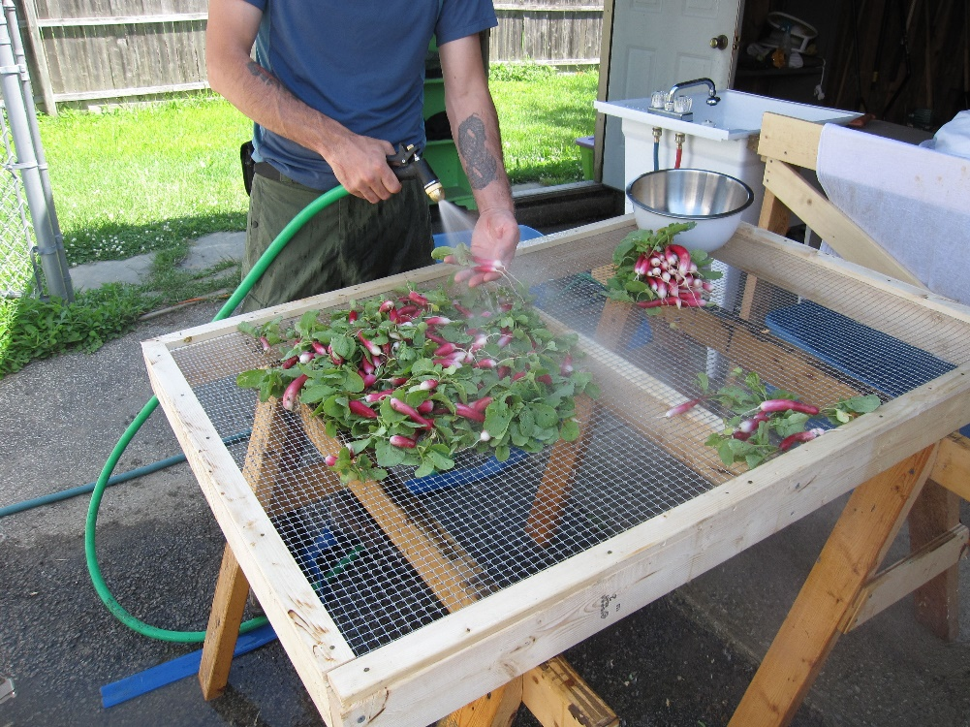
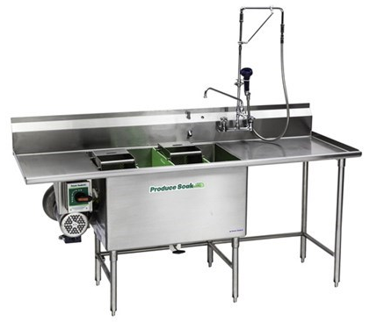
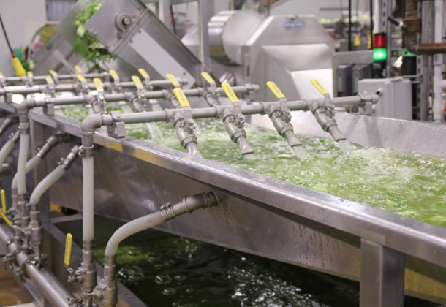
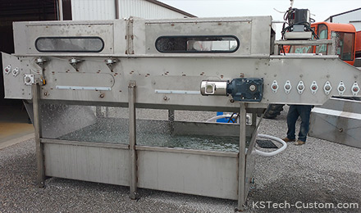
Notes:
This slide shows a variety of washing stations. The setups in the top left or top right may be all a small operation needs. The equipment in the two bottom slides are for growers that are harvesting a larger quantity of produce. The one on the left is spray washing produce as it passes under the hood on a conveyor belt. The one on the right is a system where produce floats down the wash tank.

Slide 21
Chlorination of Wash and Cooling Water
Chlorination reduces transfer of contamination
Maintain constant chlorine by monitoring.
In general 100-150 ppm.
Monitor pH of water.
Optimum range 6.0-7.0
Be conscious of water temp.
High temp results in quicker pathogen kill, but also results in rapid loss of chlorine due to gas formation.
Water disinfection options:
Chlorine gas, sodium hypochlorite, Calcium hypochlorite, Chlorine dioxide, Acidified sodium chlorite, Surfactants, Ozone, Ionizing radicals, Hydrogen peroxide, Peroxyacetic acid, Ultraviolet Illumination.
Notes:
Chlorine is a commonly used sanitizing agent in wash water and pre-cooling water. It is important to monitor chlorine levels and pH regularly and record the levels.

Slide 22
Ethylene
Ethylene is a simple hydrocarbon gas (C₂H₄); produced when organic materials are burned with too little oxygen.
Poorly adjusted forklifts, gas or wood heaters
It is also a ripening hormone for plants.
Ethylene in a storage area can cause serious produce quality problems.
High ethylene producing produce stored with ethylene sensitive items can cause premature or over-ripening and quality loss.
Can cause yellowing or browning, softening, spotting, sprouting in potatoes, flavor degradation, etc.
Notes:
Ethylene is a natural ripening compound produced by plants. Ethylene can continue to ripen produce after harvest. This can cause degradation of produce. It is best to store high ethylene producing produce away from highly perishable produce. Cool temperatures also slow down ethylene production.

Slide 23
Notes:
This graphic shows produce items that are high ethylene producers and those that are highly sensitive to ethylene. Produce in the orange box should be stored separately from produce in the green box.

Slide 24
Resources
ucce.ucdavis.edu/files/datastore/234-1450.pdf
https://attra.ncat.org/attra-pub/summaries/summary.php?pub=378
www.fruit.cornell.edu/berry/postharvest/postharvestpdfs/FS100.pdf
USDA Handbook 66 https://www.ars.usda.gov/northeast-area/beltsville-md/beltsville...research.../ah66/
http://www.familyfarmed.org/publications/wholesalesuccess/
Notes:
Resources on postharvest handling. The USDA Handbook 66 is a very in depth resource that has lots of good information on just about every crop grown in the US. The others listed are not as in depth, but have some great information on proper storage temperatures, appropriate washing methods and pre-cooling methods, produce grades, and more.

Slide 25
Questions?

