Slide 1
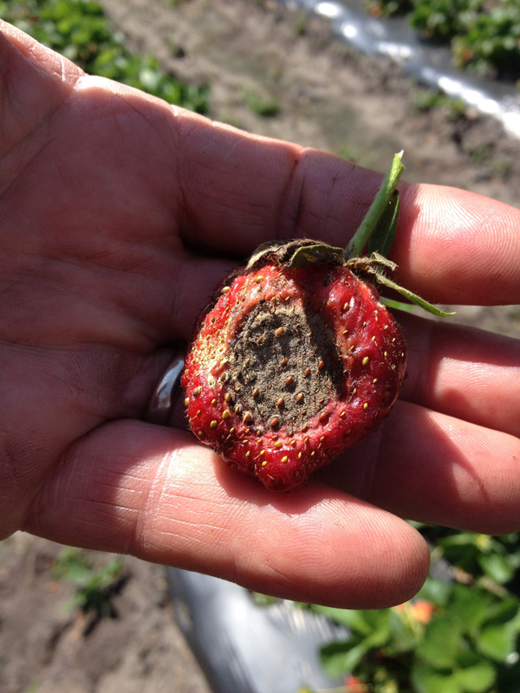
Strawberry Disease Management
Zack Snipes
Area Horticulture Agent
Anthracnose Fruit Rot on Strawberry Zack Snipes 2018
Notes:
One of the biggest challenges to producing strawberries is disease management. The varieties we plant are susceptible hosts to diseases and we have weather conditions that are favorable for disease development throughout our growing season. Without proactively managing diseases, yields will be lower and labor costs will be higher. This presentation aims to inform growers of when to expect diseases, how to correctly identify them, how to mitigate their impact, and give growers some tools to use to increase yields and sustainability.

Slide 2
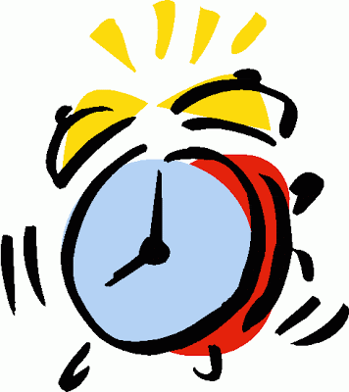
Timing
Planting-Flowering
Flowering-Harvest
Crown Rot (Fungi)
Botrytis or Anthracnose
Phytophthora Crown Rot (Oomycete)
3. Leaf Spot/Scorch
4. Angular Leaf Spot (bacteria)
Gray Mold (Fruit)
Anthracnose (Fruit)
Angular Leaf Spot (bacteria)
Powdery Mildew
This Photo by Unknown Author is licensed under CC BY-SA-NC
Notes:
As an extension agent, I think about diseases on all crops in when they occur. When it comes to strawberries there are 2 main seasons for disease development and each is managed differently. I have ranked each management season based on my experience on which diseases are more common. The first development period for diseases is from planting to flowering. This season occurs between October and early March. Most of the disease management during this period comes before planting and goes on for about a month. There are preventative measures that we can take to manage these diseases to ensure we have a healthy plant going into the next management season which is flowering to harvest. There are 4 diseases that we are concerned with during this period. I have highlighted the first two, gray mold and anthracnose, because they are seen on the fruit and cause substantial yield losses. I will go more into identification and management in the next few slides.

Slide 3
Planting to Flowering Disease Management
Crown Rot
Treat transplants in trays
Phytophthora Crown Rot
Inject mefenoxam
or metalaxyl
Transplant Trays
Zack Snipes 2019
Notes:
Our first management season is from planting to flowering. The big 2 diseases that I see are crown rot which can be caused by Botrytis or Anthracnose and Phytophtora crown rot. When you receive your trays from your transplant supplier, you should check each tray and a few plants from each tray to ensure they are healthy. If you suspect you have unhealthy plants, then pull out your knife and slice the plant through the crown and look for discoloration. If the crowns of your plants are white and clean then you should be fine, but if they are discolored (red or brown) then you may want to treat your plants BEFORE you plant. It is more economical to treat your plants in the tray before you put them in the field. If fungal crown rot is a problem then simply dip plants in a fungicide bath or spray them in the tray with a backpack sprayer.
Once strawberries are planted, they need to be checked regularly for survivability. Often times strawberries are watered in which creates a wet environment that pathogens such as Phytopthora love. If you see wilted plants particularly in wet, heavy spots in the field then you should pull a sample and check for Phytopthora. If you confirm that Phytopthora is the culprit, then a spray or injection in the irrigation water of mefenoxam or metaxyl should be used.
In many cases, these diseases can be less severe if fields are rotated away from strawberries each year.
If you are unsure which pathogen or disease you have, please consult with your local Extension agent to get proper identification. The reason this is important is because fungicides that work on fungal pathogens like Botrytis and Anthracnose will not work on pathogens such as Phytopthora as it is an oomycete and not a fungi.

Slide 4
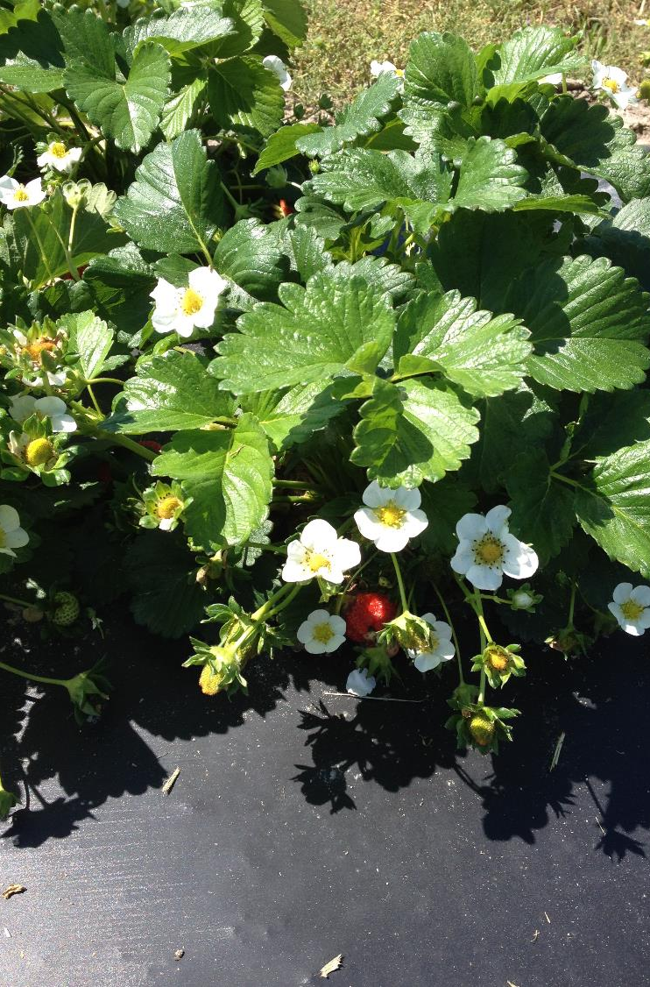
Flowering to Harvest Disease Management
Strawberry in Bloom
Zack Snipes 2018
Notes:
So now we have a healthy, strong stand of strawberries due to our proactive management of crown rot organisms during the establishment phase. Now we get into the most important time for managing strawberry diseases, particularity the diseases that cause fruit rot. I want to reiterate the 4 diseases we should be concerned with. 1. Botrytis or gray mold. 2. Anthracnose fruit rot 3. Angular leaf spot and 4. powdery mildew. The first two dieases cause rot of the fruit. Diseses number 3 and 4 cause disease on the leaf which reduces vigor of the plant and will result in overall yield loss. Angular leaf spot is a bacterial disease that is seen during rainy or extremely humid times of the year. Scout your fields early in the morning and turn over the individual leaves. You will see a yellow, wet sticky substace on the underside of the leaves. As the disease progresses you will see the angular lesions. This disease can impact yield but I have not seen it become too big of an issue during my time as an agent. We have several products that easily take care of it. Powdery mildew is a disease that is seen in dry weather. Leaves will become curled, off color (reddish) and have a white powder on them. Fungicides can easily take care of this disease.
Now lets re-visit the first two diseases. Most infections by these pathogens happen during flower development. SO if you are seeing lots of fruit rot the infection likely happened weeks ago…around 35 days ago. Think back and ask yourself did you miss a spray? Once we begin managing for these two diseases we have to stay on top of them by scouting, cleaning plant tissue and rotten berries, and staying on a strict spray program. The next slide will give us more insight to the two diseases.

Slide 5
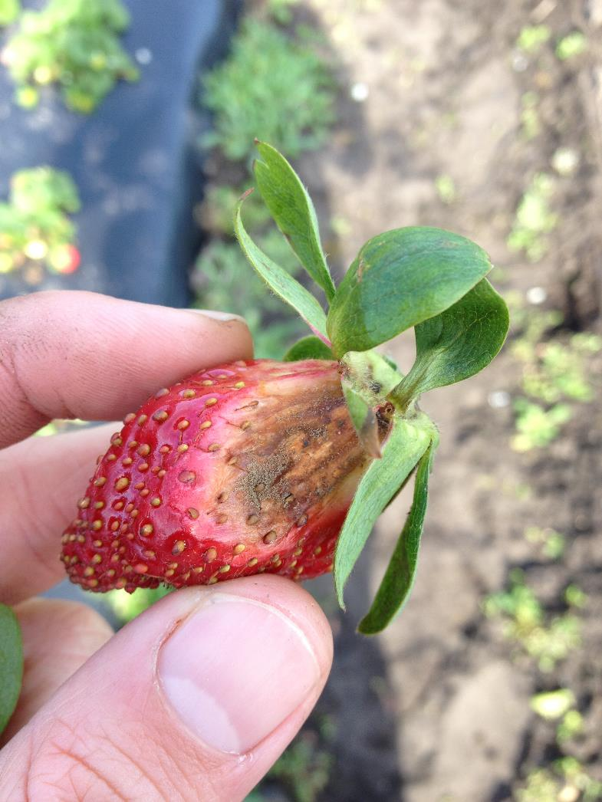
Botrytis and Anthracnose Videos
https://phytographics.myportfolio.com/strawberry-diseases
Botrytis (Gray Mold) on Strawberry
Zack Snipes 2019
Notes:
Dr. Guido Schnabel and Madeline Dowling with Clemson University Plant Pathology did an incredible job making some videos that show how Botrytis and Anthracnose Fruit Rot develop. After watching the videos you will be able to:
identify the disease
Recognize weather conditions conductive for disease development
Understand the pathogen and hosts life cycle
Be able to make cultural, biological, mechanical, and chemical management decisions to mitigate the disease

Slide 6
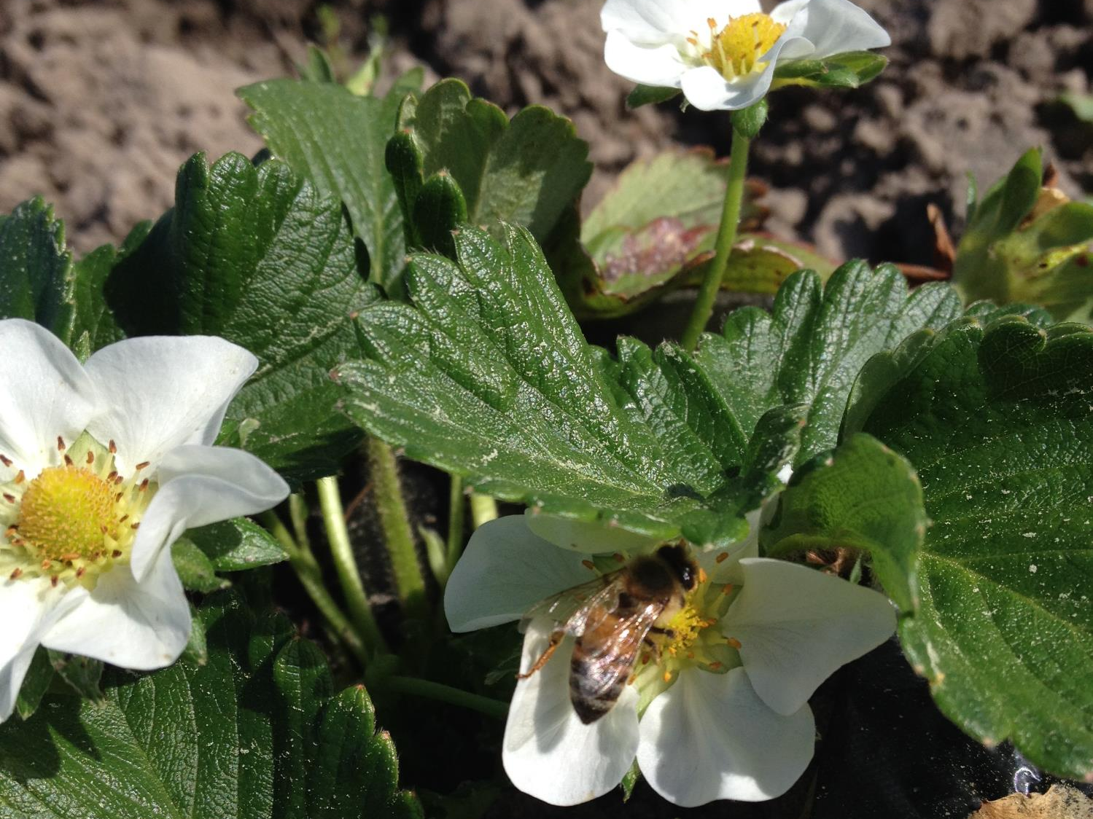
Smallfruits.org
http://smallfruits.org/assets/documents/ipm-guides/StrawberryIPMGuide.pdf
Early Spring Pollination
Zack Snipes 2015
Notes:
Now that everyone knows the diseases we are battling, I want to direct you to a resource that should be of interest to you. Smallfruits.org is collection of resources put together by scientists from the Southeast. When you visit the website you will see a production guide for strawberry. In the guide it highlights what fungicides to use and when to use them. It also references post harvest intervals and rates for each pesticide. Please visit this site before the season.

Slide 7
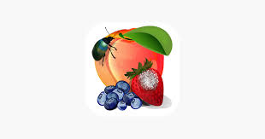
MyIPM App
https://www.clemson.edu/extension/peach/commercial/diseases/myipmsmartphoneappseries.html
Crown Rot on Strawberry
Zack Snipes 2018
Notes:
If you have a smart phone you need to download the MYIPM app. This app is a synthesis of the smallfruits.org website. The app is a large file so you will need to download when you have WiFi Service. This app has both insect and disease pests of strawberry. You can browse through the pictures of, lets say, diseases and find a gallery of photos for each disease. Once you decide that is the disease you have you can check out chemical options. There will be a chart that clues you into the mode of action, the efficacy, the active ingredient, the trade name, the rate per acre, and the post harvest and re-entry intervals. There is even a section in the App for Organic management. This is what I call an Extension Agent in your pocket.

Slide 8
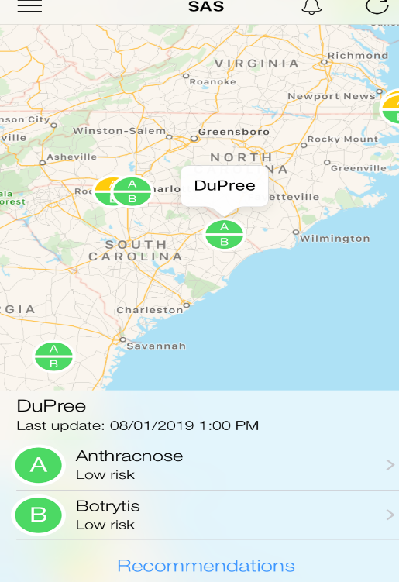
Weather Stations
Disease Forecasting at Boone Hall Farms
Zack Snipes 2017
Notes:
I wanted to touch on a few more tools that we have. I have been working with this project for about 5 years now and I am actively trying to recruit more growers. This is a weather station that takes temperature, rainfall, humidity, and leaf wetness measurements. The information is gathered and sent to a cloud based system that computes when a disease event will take place based off weather measurements. The alert is then connected to your phone via an app and will send a text or email when the event may take place. You can check on the app at any time to see if you are “green” no disease development, yellow “warning that disease can develop” or red “disease is immanent” We have one of these stations on a local farm and it has saved them multiple sprays per year because they are using data to justify pesticide sprays. This station paid for itself within 2 years by decreased pesticide applications. The customers like the idea that the farm is being more aware of pesticides and their health and environmental health. It’s a win-win for everyone. This station costs around $3000 with a monthly $100 subscription fee. I would be willing to split the cost if I had any interested growers.

Slide 9
Resistance Management
Sampling Strawberry for Botrytis Resistance
Zack Snipes 2016
Notes:
Dr. Guido Schnabel has developed a method to check for Botrytis resistance within each grower’s field. I will be glad to help you out with this and I can pass on the instructions. You send in 30-40 flower blossoms or you use Q-tips to swab botrytis from infected fruit. They are mailed to the lab on campus and within a week or so results are sent via email. They test isolates from your field to tell you which fungicides will work on your farm and which will not. This will keep you from spraying a product which the pathogen is resistant to on your farm. A farm next door or even your field within the season can change based on the pathogen and spray pressure. Please take advantage of this program. Call me if you need help.

Slide 10
Tips for a Successful 2020
Buy chemicals now…or as a Christmas present
1 protectant and 2-4 heavy hitters
Notes:
One of the biggest frustrations I have as an agent is when folks call me and ask which fungicides to use after they spot a disease. It comes as no surprise which diseases we WILL have. I can promise you that you will have Botrytis and Anthracnose every season so prepare by purchasing fungicides for those diseases now…ahead of the season. You should have in your arsenal one protectant fungicide that will serve as the backbone of your spray program. Captan or realated product comes to mind. The other products you should have are the curative and systemic products that serve to “clean up” the disease once you spot it in your field. Do yourself a favor and invest in those products before the season starts. I promise you will use them. It will save you time and worry if you do it now.

Slide 11
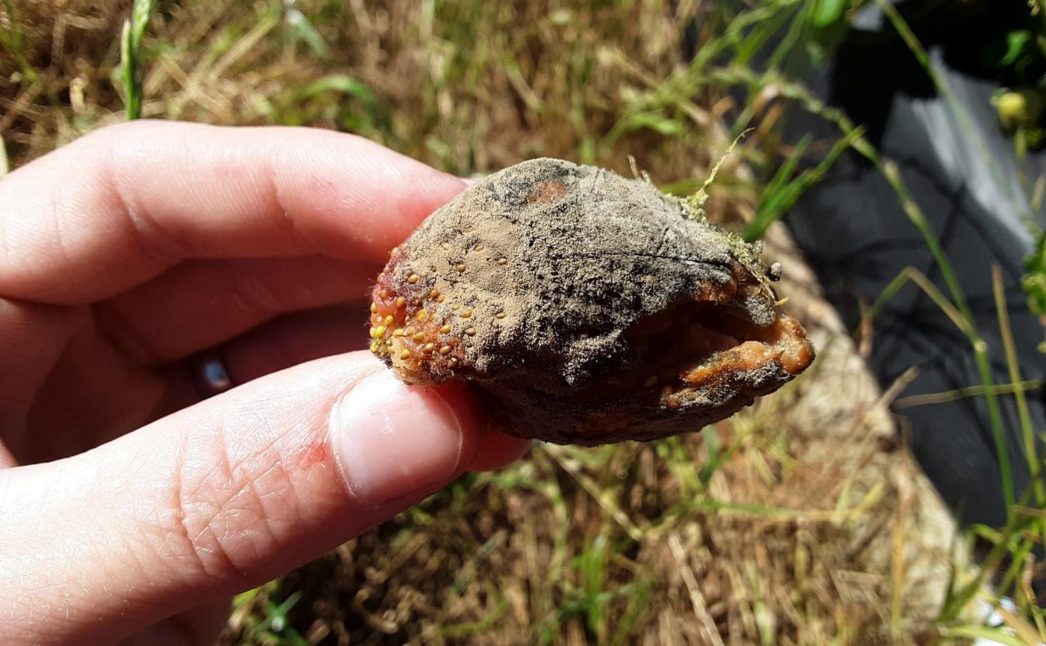
Tips for a Successful 2020
Botrytis Fruit Rot
Justin Ballew 2019
Sanitize
Notes:
One of the best disease management tools is to sanitize. You saw how important this was in the videos but I cannot stress enough how important it is. The best and usually the cleanest, disease free fields I see are those who are on top of keeping dead plant and fruit material out of the field. Look at this picture. By removing this berry you are removing hundreds of thousands if not millions of spores from your field. Each one of those spores could cause an infection. Yes it costs money to do this but I promise the investment is worth the reward.

Slide 12
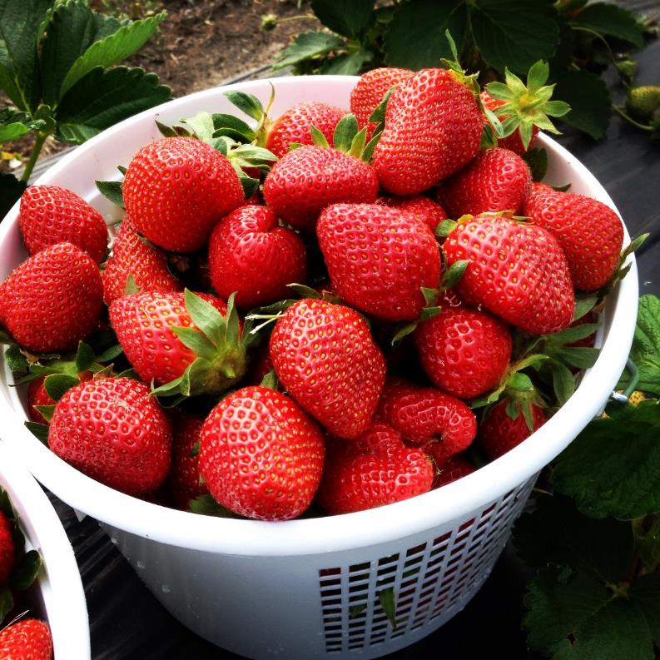
Tips for a Successful 2020
Don’t get behind on spraying fungicides
Get fungicides out ahead of the rain
Wabi Sabi Farm
Zack Snipes 2016
Notes:
Now that you have your chemicals in the pesticide shed and have spent the early season scouting and sanitizing, now you should be thinking about using fungicides. Do not get behind on spraying them. Once you start spraying, do not stop spraying. If it is rainy, moist, humid you will spray more often than if you are in a drier period. Typically you should be spraying every 7-10 days but that can be spread out to 14 days or longer during dry periods. One last point on spraying, get your fungicides out before a rain event. Pesticides work much better at prevention rather than stopping the disease.
If you follow the guidelines presented tonight then you will have significantly less disease in your strawberry crop this season. You will make more money and sleep better at night. Do not hesitate to call me if you have any questions.

