Slide 1
Dairy Module 1: breeds and selection,
Tina Horn, Mark Cathcart, and Alana West

Slide 2
Objectives
In this module you will learn about the six major dairy breeds, their physical characteristics, origin, production capabilities, and other facts that make them unique or different from the other breeds. In addition, you will gain insight into why some producers may choose one breed over another and the strengths and weaknesses of each breed.
You will also learn about pedigrees and common dairy terms

Slide 3
Learning Objectives:
Cloverbud (Ages 5-8) should:
  Be able to identify the six major dairy breeds and one interesting fact about one of the breeds.
  Know the difference between of a cow, a heifer, and a bull.
Juniors (Ages 9-13) should:
  Be able to identify the six major dairy breeds, the largest and smallest breed, the highest producing breed in pounds of milk, the highest producing breed in butterfat percent
  Know key terms on the first slide of dairy terms
Seniors (Ages 14-18) should:
  Be able to identify the six major dairy breeds and their physical characteristics (color, size, and production rank)
  Know the meaning of the highlighted terms throughout the module
  Understand the difference between recessive and dominate genes and be able to give an example
  Be able to read a basic pedigree

Slide 4
Overview of Breeds, Selection, and Terms
Beef vs Dairy
Focus on 6 major Dairy Breeds
Breeds and Selection
Pedigrees
Dairy Terms

Slide 5
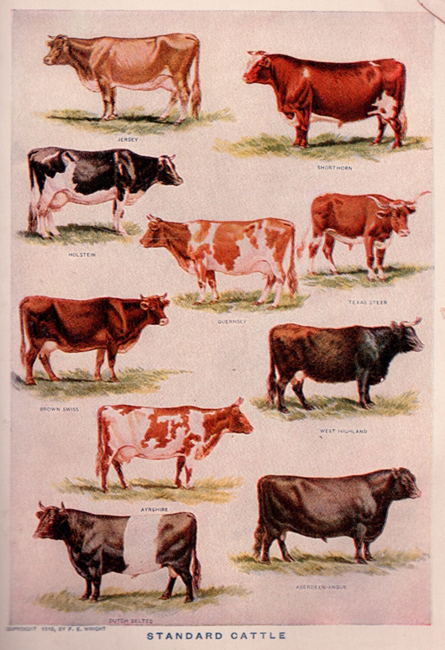
Cattle Breeds
Cows come in all shapes and sizes
And are raised for human use
Consumption and Work
Those with common size, color, abilities, and other characteristics are classified as breeds
Cattle are broken down into 3 Categories
Dairy
Beef
Dual purpose

Slide 6
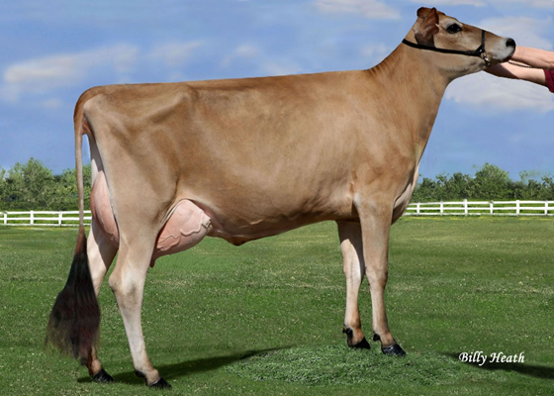
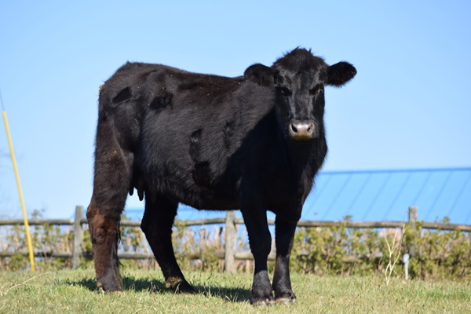
Cattle Breeds
Dual Purpose used for both meat and milk
Dairy Breeds
Utilized for milk production
Do well in converting feed and forages into milk
Characteristics
Lean
Angular
  Well developed mammary system
Beef Breeds
Utilized for meat production
Do well in converting feed and forage into meat
Characteristics
Heavy muscle
Rapid growth

Slide 7
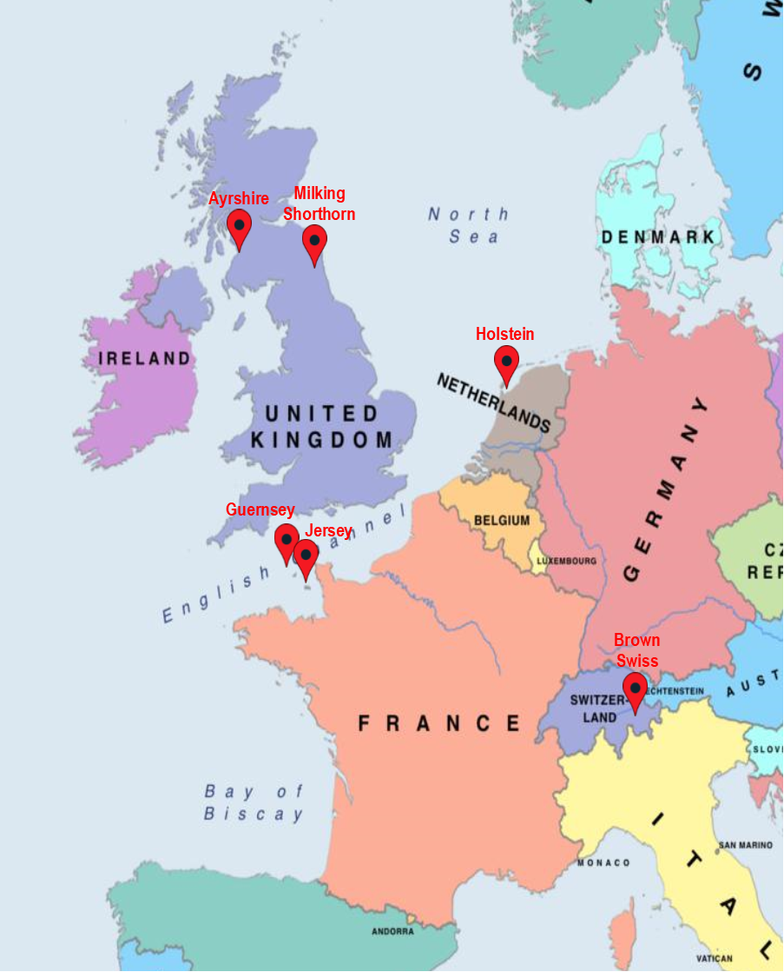
Dairy Breeds
There are over 800 different breeds of cattle in the world
Only 8 of these breeds are characterized Dairy
Holstein
Red and White Holstein
Jersey
Guernsey
Brown Swiss
Ayrshire
Milking Shorthorn
Milking Devon
All of the major dairy breeds originated in Europe

Slide 8
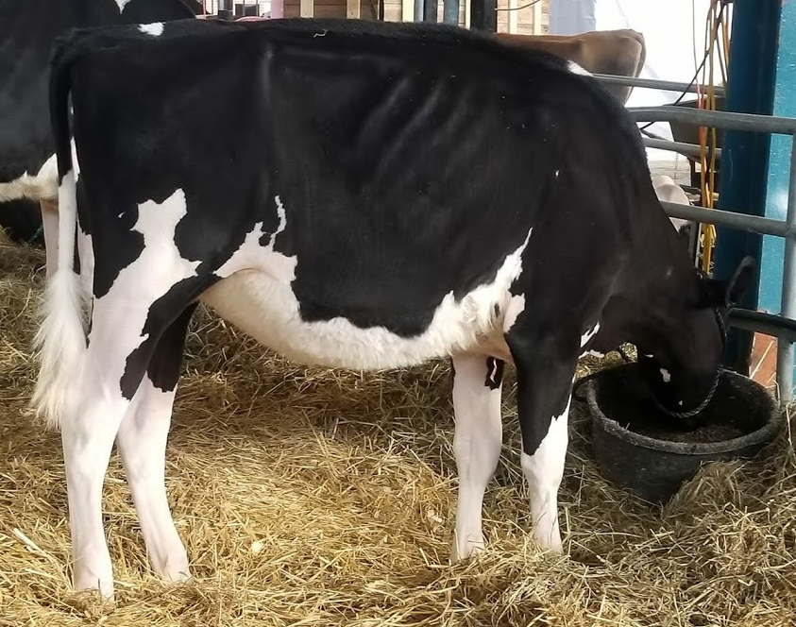
Holstein
Color Pattern:
Black & White or Red & White
Can be mostly black, mostly red, mostly white
or anywhere in between
Origin:
the Netherlands
Came to the US in 1852
Size:
Largest of the Dairy Breeds
Average mature cow weighs 1,500#
and stands 58 inches tall at the shoulders
Production:
Average U.S. Production 25,000# of milk/lactation
Produce more milk than any other dairy breed
Average Fat content in milk: 3.65%
Average protein content in milk: 3.2%

Slide 9
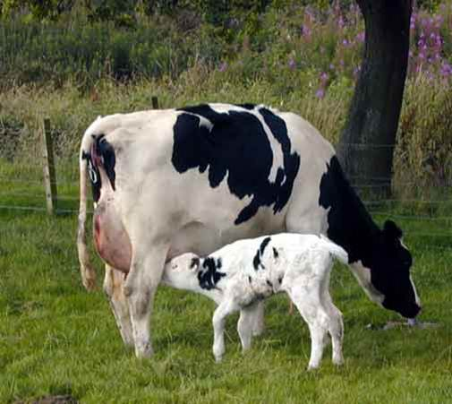
Holstein
Holstein calves weigh an average
of 90# at birth.
The most popular dairy breed and make up
90% of the US dairy population.
The World Record holder for
milk production is a Holstein;
Selz-Pralle Aftershock 3918
produced 78,170 of milk in
one lactation in 2017.
The Holstein breed is known for high milk production, but has less butterfat and protein based on percentage in the milk, compared other breeds.

Slide 10
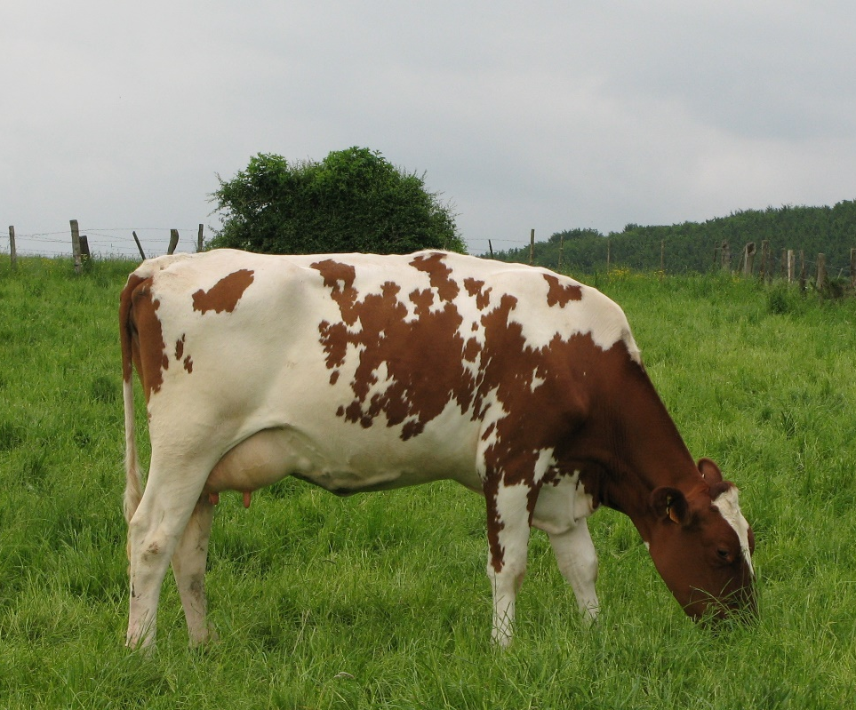
Holstein
The Red and White coloring in some Holsteins is caused by a recessive gene and appears when the dam (mother) and sire (father) are both carriers
Just like in humans, every animal inherits two genes for each trait from their parents. Some genes are more dominant than others. For example, brown eyes are dominant over blue eyes. If someone has a brown eyed gene and a blue eye gene, they will have brown eyes. They will only have blue eyes if both genes are blue.
The brown eyed gene is called the dominant gene and the blue eyed gene is the recessive gene, just like the black hair coat gene is dominant and the red hair coat is recessive.

Slide 11
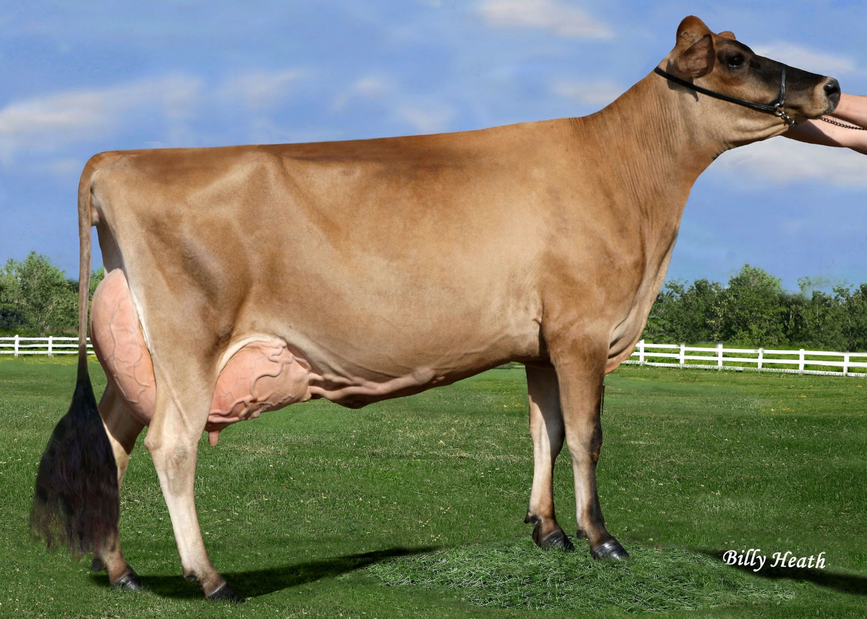
Jersey
Color Pattern:
Vary from a very light gray or mouse color to a very dark fawn or a shade that is almost black. White markings are also acceptable.
Origin:
The Isle of Jersey in the English Channel
Came to the US in early 1850’s
Size:
Smallest dairy breed
1,000# mature weight
Production:
Produce milk with highest fat and protein Average U.S production: 18,020#s
Average Fat: 4.8%
Average Protein: 3.7%

Slide 12
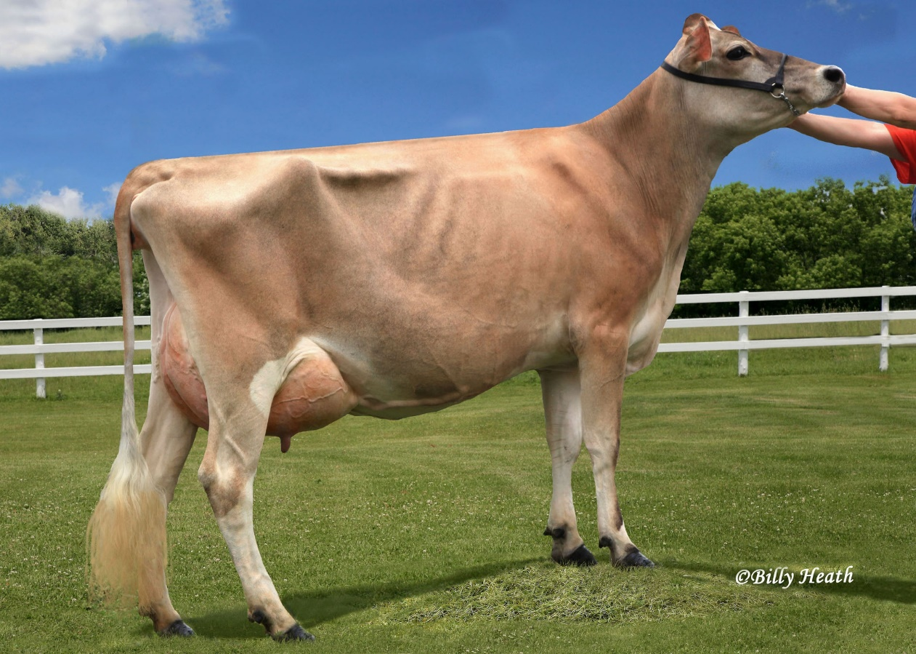
Jersey
Jerseys are the most efficient of the dairy breeds. They produce more milk per pound of body weight that any other breed.
They are also know for high fertility rate and low dystocia rate (calving difficulty) but have a high rate of hypocalcemia (milk fever).
Milk Fever is a disorder that occurs following the cow giving birth when milk production exceeds the cows ability to mobilize calcium.

Slide 13
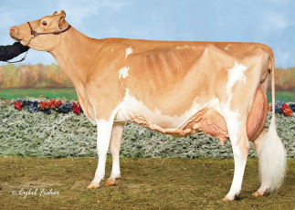
Guernsey
Color Pattern:
Fawn (light reddish brown) to red and white
Hooves, udder, tail, and muzzle do not have pigment so in a purebred these will always be white or cream colored
Origin:
The Isle of Guernsey in the English Channel
Came to the US in 1840
Size:
Moderate in size
1,200# mature weight
Production:
Average U.S production: 17,000#s
Average Fat: 4.7%
Average Protein: 3.4%

Slide 14
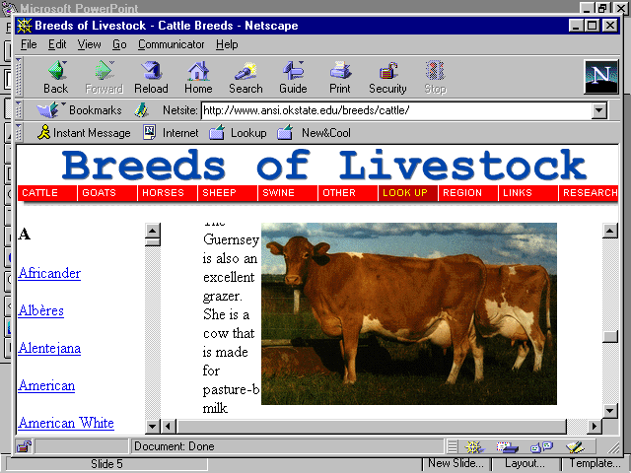
Guernsey
Guernsey milk is “golden” in color due to the high protein and fat components and also because of a high concentration of beta-carotene.
Beta-carotene is also the pigment that gives carrots their orange color. The body converts this substance to Vitamin A, which is important for healthy eyes, immune system, skin, and mucous membranes.

Slide 15
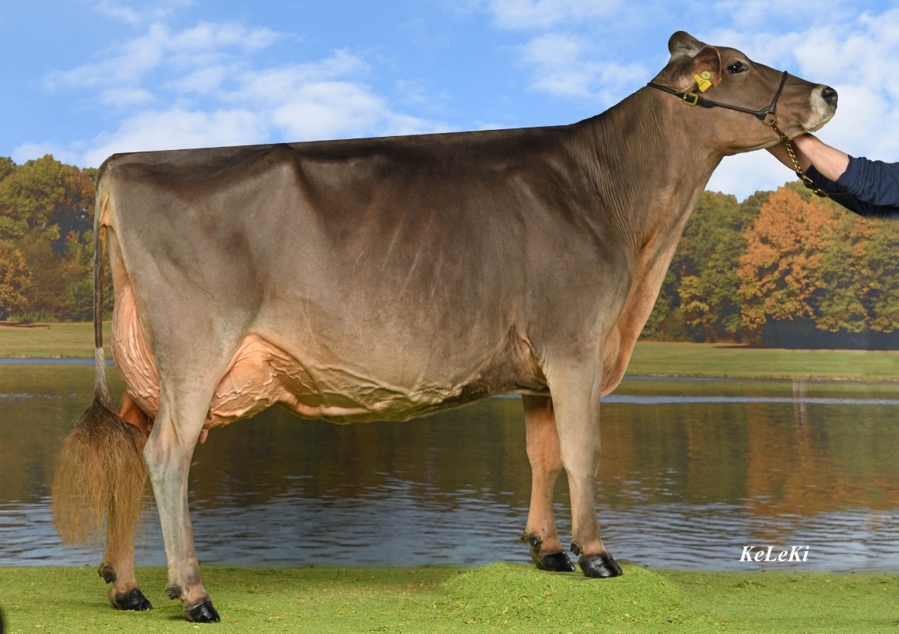
Brown Swiss
Color Pattern:
Range from a deep brown that is almost black, to a light greyish brown.
Will also have a dark tail switch, dark hooves, deep brown eyes and a black nose.
Origin:
Switzerland
Came to the US in 1869
Size:
Larger dairy breed (2nd in size to Holstein)
1,500# mature weight
Production:
Produce milk with highest fat and protein Average U.S production: 22,040#s
Average Fat: 4.0%
Average Protein: 3.5%

Slide 16
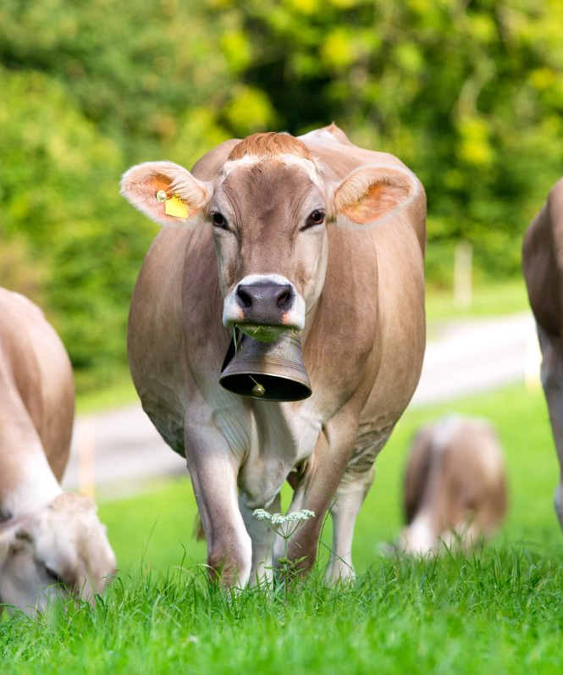
Brown Swiss
Brown Swiss are known for having very good feet and legs. Sound feet and legs were a must for the beginnings of the breed in Switzerland grazing the mountain slopes.
Originally known as a dual purpose breed
utilized for meat and milk.
Brown Swiss have the longest gestation period of the dairy breeds- 287 days.
This is 7 days longer than the average gestation of 280 days.
Gestation period is the length of time the
animal is pregnant.

Slide 17
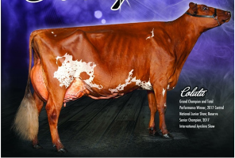
Ayrshire
Color Pattern:
Red and white- Can range from a light shade of orange to dark brown.
Can be nearly all white or all red
Brindle and Roan color patterns are also possible
Origin:
The County of Ayr in Scotland
Came to the US in 1822
Size:
Moderate sized dairy breed
1,400# mature weight
Production:
Average U.S production: 14,500#s
Average Fat: 3.9%
Average Protein: 3.3%

Slide 18
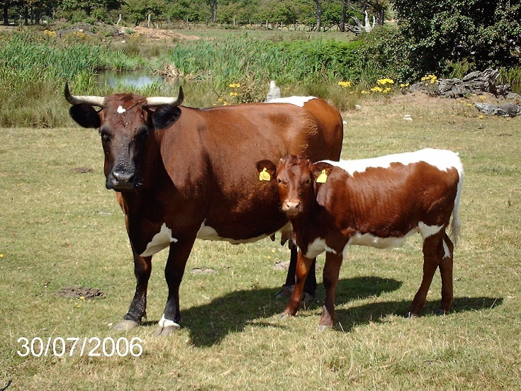
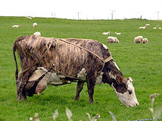
Ayrshire
Ayrshire were once known for their horns. If properly trained, they would gracefully curve out and could grow up to 2 feet or more in span.
Horns are not practical now and can unintentionally cause injury to other cattle and people, so cattle born with horns are dehorned at a young age.
Another distinct characteristic of Ayrshire cattle is the possibility of a brindle or a roan hair coat.
Brindle is a coat coloring pattern in animals that is sometimes described as "tiger-striped“. The streaks of color are irregular and darker than the base color of the coat, although very dark markings can be seen on a coat that is only slightly lighter.

Slide 19
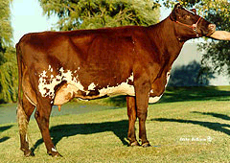
Milking Shorthorn
Color Pattern:
Red, red with white markings, white, or roan
Origin:
Northeastern England, in the Valley of the Tees River
Came to the US in 1783
Size:
Moderate sized dairy breed
1250# mature weight
Production:
Produce milk with highest fat and protein
Average U.S production: 15,000#s
Average Fat: 4.0%
Average Protein: 3.5%

Slide 20
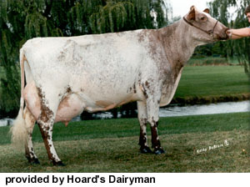
Milking Shorthorn
Like Ayrshires, Milking Shorthorn can also be Roan in color. In these breeds, white and red coat color genes are co-dominant, resulting in the roan (evenly mixed white and red) and unique color patterns.
Milking Shorthorn are another dual purpose breed. However, in many cases there is more of a distinction between those that are used for milk and meat. They are registered as Milking Shorthorn or just Shorthorn.

Slide 21
Dairy Breeds and Selection
Traits and Selection
Milk Production Facts
Breed body wt. fat lbs. Fat lbs. Milk
Holstein 1,500 3.65 912 25,000
Ayrshire 1,250 3.95 572 14,000
Jersey 1,000 4.80 864 18,000
Brown Swiss 1,500 4.00 880 22,000
Guernsey 1,200 4.70 799 17,000
Things to Remember
Each of these breeds have strengths and weaknesses that producers have to take into account when they are deciding which breed(s) will make up their herd.
Holsteins produce the most milk, but have the lowest butterfat, are the largest of the breeds, and require more feed than most.
Jerseys produce one of the least amounts of milk, but have the highest butterfat and require less feed.
Brown Swiss are similar in size and feed requirements to a Holstein, but produce less milk. However, they are know for having very sound feet and legs and longevity y(they stay in the herd a long time).
Guernsey produce less milk, but are known for producing milk high in beta-carotene and A2/A2 milk.

Slide 22
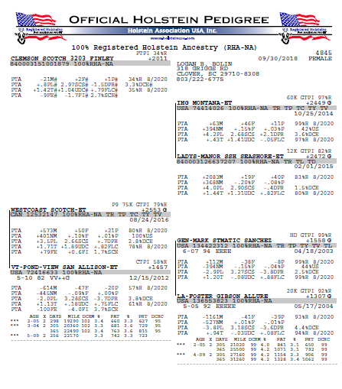
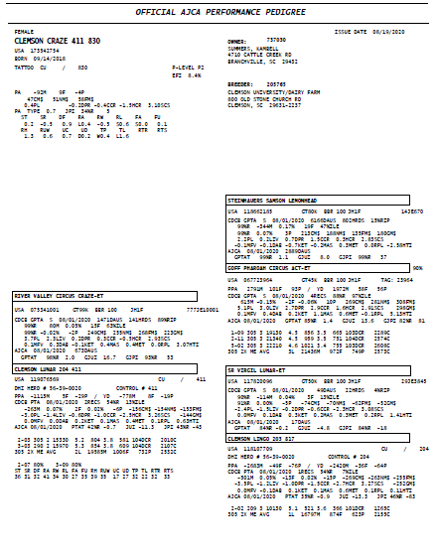
Reading Pedigrees
Pedigree formats and most information contained in them is the same regardless of the breed

Slide 23
Reading Pedigrees
The top portion of the pedigree has information about that particular animal and what she may be genetically capable of producing
Breed and what percentage registered
Date of Birth
Animal’s Name
Registration number
genetic averages or numbers
identification number,
Owner

Slide 24
Reading Pedigrees
The remainder of the pedigree is the information on her parents (dam and sire).
Her sire and dam are listed on the left side of the page. The sire(father) is listed on top and the dam(mother) is listed on the bottom
Information on her grandparents is listed on the right hand side as follows:
Paternal grandsire
Paternal grandam
Maternal grandsire
Maternal grandam
Information on their production and genetic averages is included under each

Slide 25
Cow Pedigrees
Breeders can have their cattle evaluated for type (conformation) through their breed association's linear classification programs. This linear classification is based on the functional soundness and appearance of the animal. Classification scores are a tool producers can use to breed, develop and market higher producing, more durable cows.
This information can also be found on the pedigree
On a cow that has been classified, it will show her classification score and at what age she was classified
This cow scored Good Plus 82 when she was 5 years and 10 months old.
The letters and symbols that follow are score for specific traits.
Capacity, Dairy Strength, Rump, Feet and Legs, and Udder

Slide 26
Cow Pedigrees
A cow will also have her production records included in her pedigree for each lactation
Those records will include:
AGE- Her age when the lactation started
X-How many times a day she was milked during that lactation
Days- Number of days she milked in that lactation
Milk- Pounds of milk she produced in that lactation
DCRM- Data Collection Rating for Milk
%- Average Percent Fat
Fat- Total pounds of fat she produced during that lactation
%-Average Percent Protein
PRT- Total pounds of Protein

Slide 27
Holstein Pedigrees
PTPI (Pedigree Total Performance Index) is an index based on a combination of traits. It helps sort out animals based on their genetic potential to be the productive in a herd. It takes into account production, type, animal health traits like somatic cell count, and pregnancy rates.
PTAs (Predicted Transmitting Ability)express the level of genetic superiority or inferiority an animal is expected to transmit to their offspring and helps producers rank animals based on their genetic merit.
PTAs are listed for M(milk), F(fat), P(protein), PL(Productive Life), SCS(Somatic Cell Count), DPR(Daughter Pregnancy Rate), DCE(Daughter Calving Ease), T(Type), UDC (Udder Composite), and FLC(Feet and Leg Composite)

Slide 28
Dairy Terms
Bull - Mature male dairy animal
Cow - Mature female dairy animal that has produced one or more calves
Heifer - female dairy animal that has not borne a calf
Calf - male of female dairy animal under one year of age
Steer - a castrated male used for beef production
Freemartin - infertile heifer that is born twin to a bull calf
Polled - condition of naturally hornless

Slide 29
Dairy Terms
Springer - cow or heifer showing signs of being close to calving
Calving/Parturition - giving birth
Dairy Character - characteristics indicating the animal will be a high milk producer
Butterfat - percent of fat in the milk
Milk Production - amount in pounds of milk that a cow produces during a lactation period
Lactation - span of time that a cow is giving milk
  Usually around 300 days/year
Estrus - Animal is in heat and can be bred
  Releases egg at this time
  Occurs n average every 21 days
  Average length of estrus is 12-24 hours

Slide 30
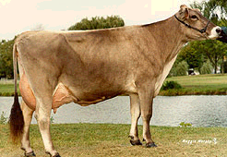
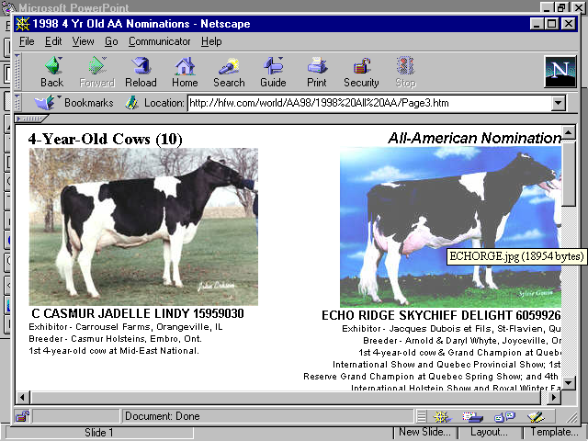
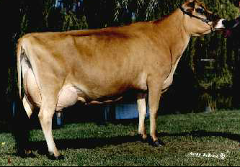
Major Breeds of Dairy Cattle
Quiz
1
2
3
4

Slide 31
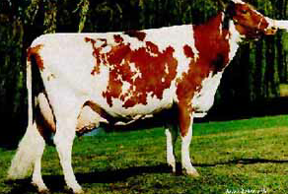
Major Breeds of Dairy Cattle
Quiz
5
6
Which breed produces the largest volume of milk?
Which breed is known for having exceptional feet and legs?
Which breed(s) can have roan haircoat coloring?
Which breed is the most efficient?
Which breed has milk that is high in beta carotene?
Which 2 breeds do you think are know as the Channel Island Breeds?

Slide 32
Major Breeds of Dairy Cattle
Quiz
Brown Swiss
Holstein
Jersey
Guernsey

Slide 33
Major Breeds of Dairy Cattle
Quiz
Ayrshire
Milking Shorthorn
Which breed produces the largest volume of milk? Holstein
Which breed is known for having exceptional feet and legs? Brown Swiss
Which breed(s) can have roan haircoat coloring? Ayrshire and Milking Shorthorn
Which breed is the most efficient? Jersey
Which breed has milk that is high in beta carotene? Guernsey
Which 2 breeds do you think are know as the Channel Island Breeds? Jersey and Guernsey

Slide 34
Dairy Breeds and Selection
Can you remember what you’ve studied?
1. What is a bull?
2. What is a heifer?
3. What is the average weight of a Holstein calf?
4. What is dystocia? Which breed is know for having very little dystocia?
5. What is a cow?
6. What is the term for the span of time that a cow is giving milk?
7 What causes the Red and White color pattern in a Holstein? Give another example of this.
8. What is the term for the length of time an cow is pregnant?
9. PTA is an acronym for what?
10. What gives Guernsey milk its golden color?

Slide 35
Answers
1. What is a bull? Mature male dairy animal
2. What is a heifer? female dairy animal that has not borne a calf
3. What is the average weight of a Holstein calf? 90pounds
4. What is dystocia? calving difficulty Which breed is know for having very little dystocia? Jersey
5. What is a cow? Mature female dairy animal that has produced one or more calves
6. What is the term for the span of time that a cow is giving milk? Lactation
7 What causes the Red and White color pattern in a Holstein? A recessive gene Give another example of this. Blue eyes
8. What is the term for the length of time an cow is pregnant? Gestation
9. PTA is an acronym for what? Predicted Transmitting Ability
10. What gives Guernsey milk its golden color? Beta Carotene

Slide 36
Author and for more information
Tina Horn- Extension Associate- Clemson University Cooperative Extension Service
thorn@Clemson.edu
Reviewers
Mark Cathcart- Union County 4-H Agent- Clemson University Cooperative Extension Service
Alan West- Newberry County 4-H Agent- Clemson University Cooperative Extension Service

