Slide 1
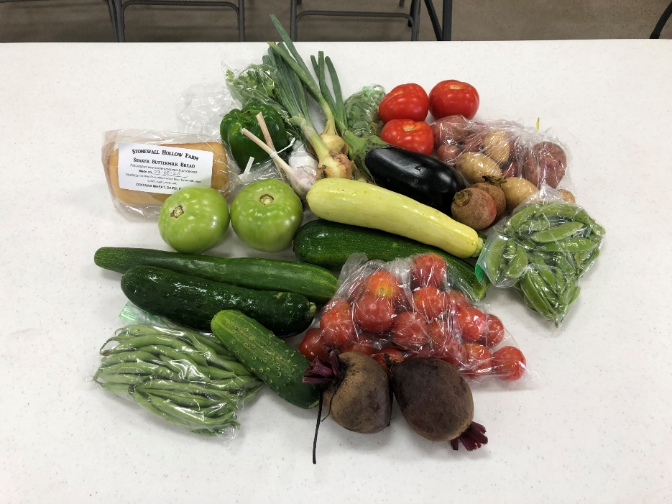
Farm Fresh to Table
Jessica Bessin
Mercer County Extension Agent for Horticulture

Slide 2

Fresh to Table
Early 2020 the Mercer County Horticulture Agent planned programs for the local farmers market with two objectives in mind.
  Increase attendance by bringing in young families
  Provide fresh produce to children
Through word of mouth, other groups in Mercer County had a similar idea of using the Farmers Market as a way to provide produce to low income families.
These groups gathered (when still possible) and made a plan to accomplish these two goals.

Slide 3
Logistics
Mercer County Farmers Market would provide fresh produce to an already established cooking club for low income families in the Mercer County School System.
  Children would visit the market once a month during the months of June, July, and August for their normal cooking club meeting.
  Receive a large bag of produce valued at $20 each with recipes that correlate with the produce.
  Receive $20 worth of veggie vouchers to shop with.
  Mercer Extension and SNAP assistant would provide educational resources and demonstrate how to prepare the produce received.
  Farmers Market Members would be reimbursed at the end of the season for produce and other products contributed in the bags.

Slide 4
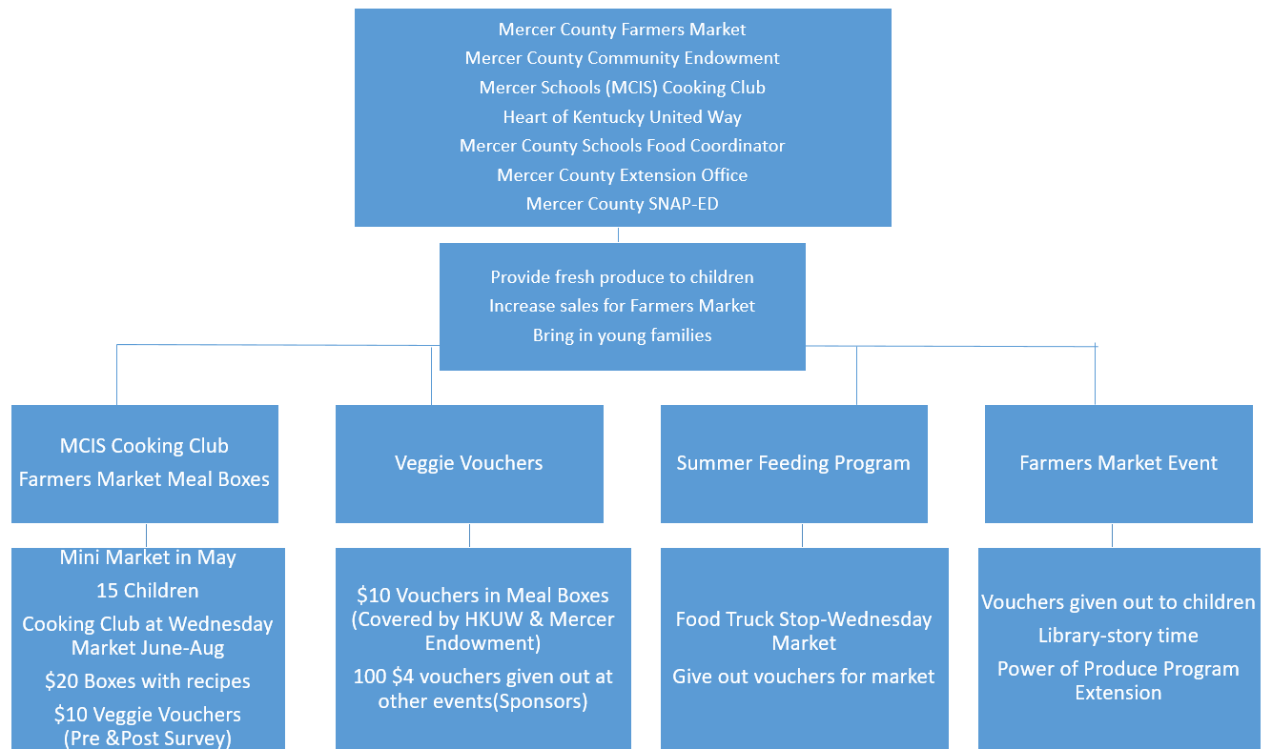
Farm Fresh to Table Logistics

Slide 5
The Team
Each group involved would played a part in getting the Farm Fresh to Table program from an idea to reality.
Funding
Mercer County Community Endowment
Heart of KY United Way
Produce /Monthly Bags
Mercer County Farmers Market Members
Educational Resources
Mercer County Extension-Horticulture Program
Mercer County Supplemental Nutrition (SNAP-ED) Assistant
Mercer County Schools-Family Resource Center

Slide 6
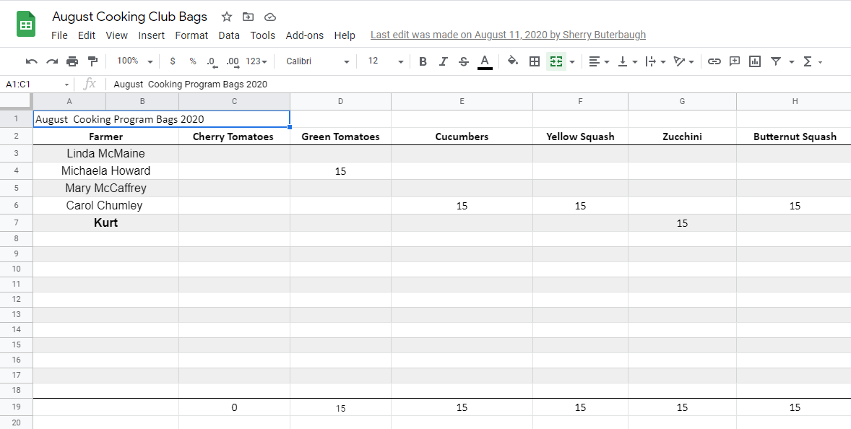
Market Prep
Week of bag pick up farmers reported in a google doc what produce they could provide.
Horticulture Agent tracked the produce that came in and share information with SNAP-ED assistant and Mercer Schools representative.
Recipes were planned based on what the farmers had available that week.

Slide 7
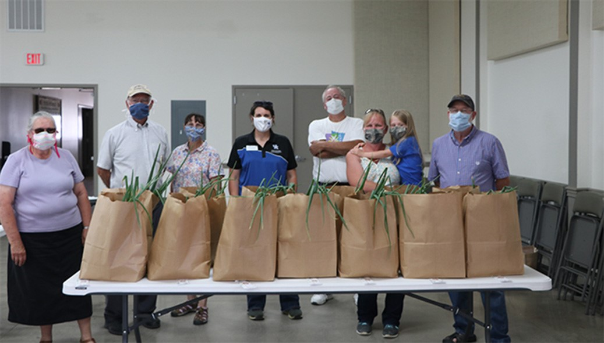
Day of Pick Up
Market members arrived an hour before market open to prepare produce.
Horticulture Agent checked in items and record amounts farmers market vendors charged per items.
Market members were paid for items by the Farmers Market.
  The market would later be reimbursed by funding partners.
Market members would start packaging bags.
Recipes and seasonings were placed in the bags.

Slide 8

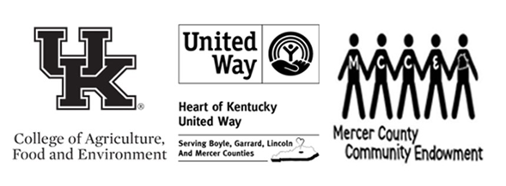
Veggie Vouchers
Upon completing a pre-survey each child received $10 of veggie vouchers in $2 increments to go with their bags.
  Children could then go through the market and purchase additional vegetables.
At the final bag pick-up, once completing a post-survey each child received an additional $10 worth of veggie vouchers.

Slide 9
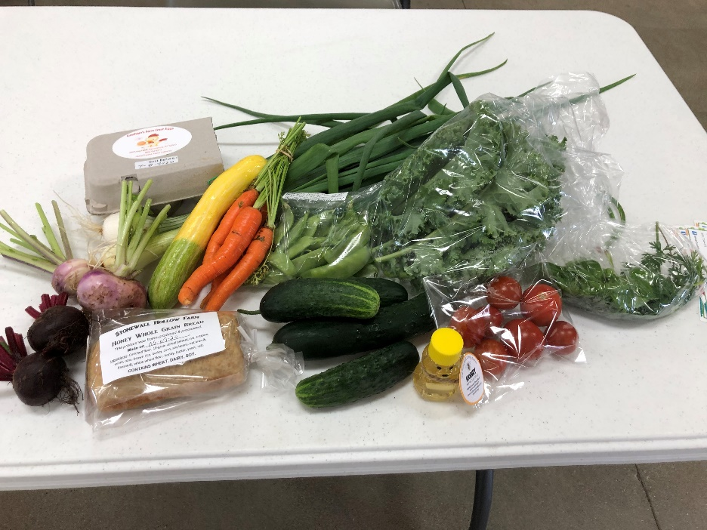

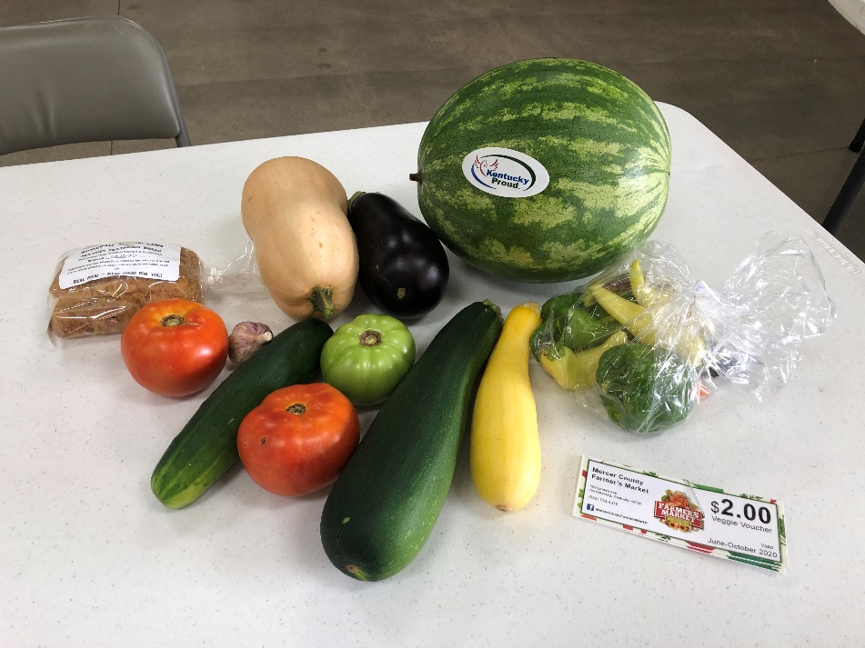
Monthly Bags
June
July
August

Slide 10
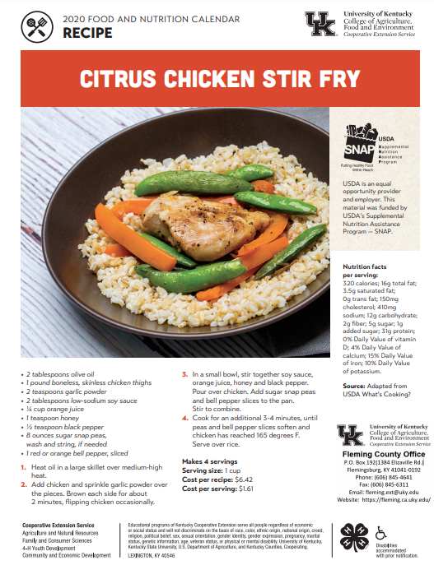
Monthly Bags
Once receiving their bags children corresponded with SNAP assistant on how to use their produce.
SNAP assistant lead a cooking demonstrations via Zoom with the recipes provided in the bag.
Children then shared photos of the recipes they created and ate with their families.

Slide 11
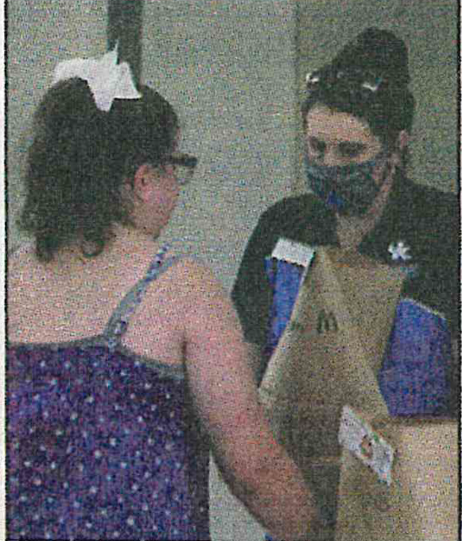
Surveys
Pre and post-survey were given to all participants.
70% of the participants surveyed said they are now adding a new vegetable to their meal planning due to the exposure of a new vegetable from this program.
100% plan to start shopping at the Farmers Market to supplement their regular grocery shopping.
One participant said “This is great for the community, I love the fresh vegetables and how it’s exposing our children to them.”

Slide 12
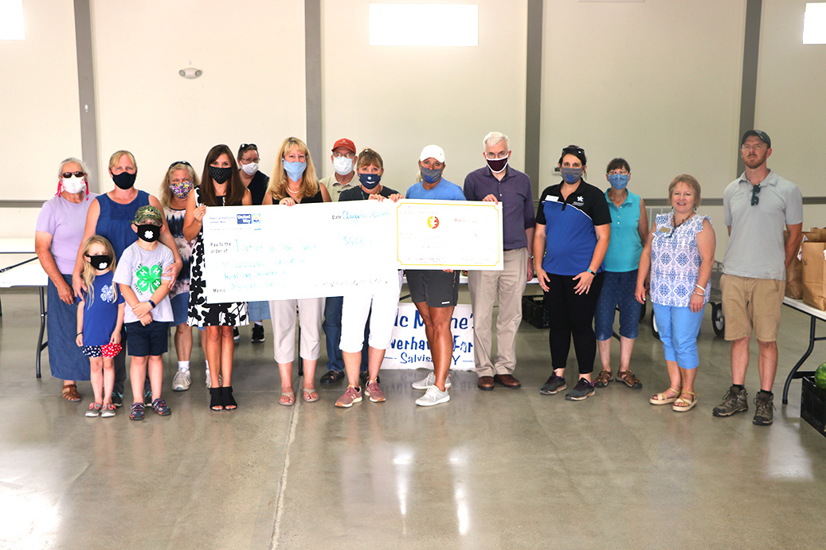
2021 Market Season
Goals for next market season
  Increase number of children who receive bags.
  Incorporate the summer feeding program.
  The market is planning on selling similar bags of produce to the public.
With the lifting of COVID restrictions lifting plan more market events to bring in young families and underserved audiences.

