Slide 1
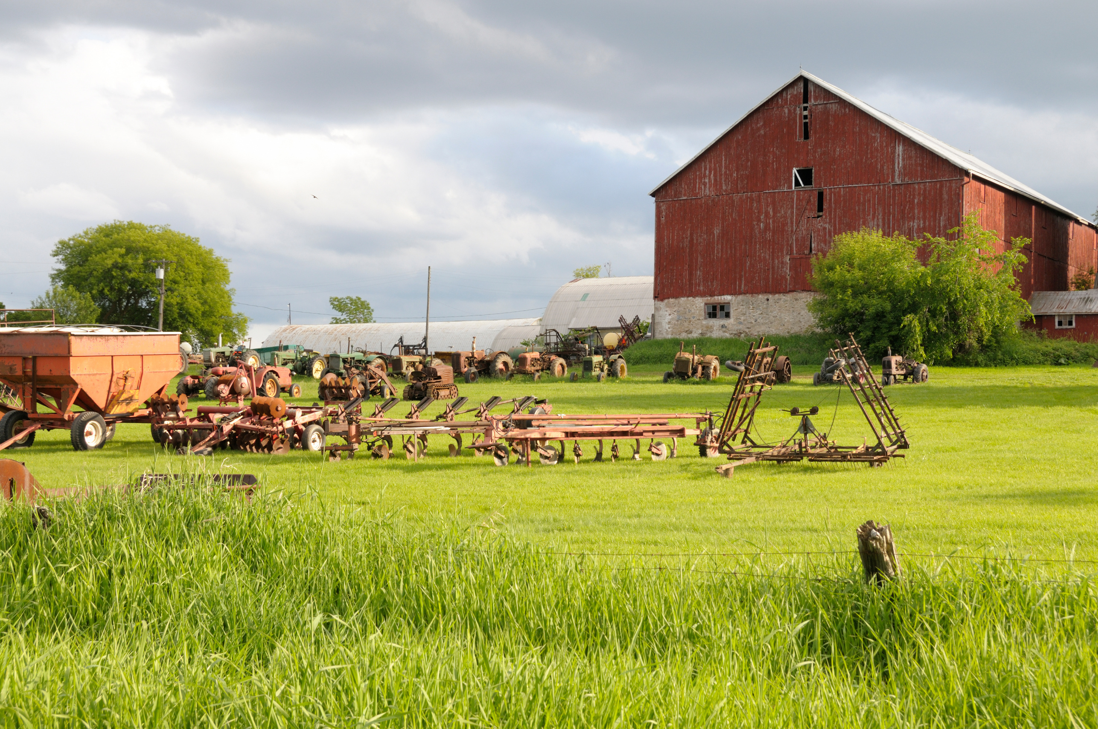
Developing a Farm
Business Plan
University of Tennessee
Center of Farm Management
Rachel Painter
rpainter@utk.edu
2025
Notes:
Welcome. I'm Rachel Painter and I have the honor of serving as a farm management specialist with the University of Tennessee Extension. In this presentation, you will learn how to start writing your own farm business plan.

Slide 2



Center of Farm Management Programs
Income Tax Seminars
Farm Transition Planning
Notes:
Before we begin, let me share a little bit about our Center of Farm Management including the programs we offer and how we can help you.
We have Extension, Research, and Teaching faculty and staff in the University of Tennessee Agriculture and Resource Economics department that are a part of our center, and we host four major programs that would potentially apply to you as a farmer in Tennessee.
Farming Fundamentals is a program for beginning farmers and is an online program available on our website farmingfundamentals.Tennessee.edu.
Master Farm Manager is for those that are not new to agriculture but are seeking to make more informed decisions in managing their farm. This program is offered both online and in person across the state, with sessions like this one on business planning as well as market outlooks, recordkeeping, budgeting, lease agreements, insurance, and more.
We also offer Income tax seminars for tax preparers or accountants in person each year, and we offer programs on farm transition planning, also referred to as Farmland Legacy programs in person.

Slide 3

Center of Farm Management – MANAGE Program
Farm Management Extension Specialists help families analyze their total farming business so they can make informed decisions regarding their future.
Review current financial situation
Capitalize on strengths and reduce weaknesses in the farm business
Develop individualized farm and financial plans
Explore enterprises and alternatives
Evaluate capital investment opportunities including land and/or machinery purchases
Analyze potential impacts of changing the scope of the enterprise
Find out more at
Manage.Tennessee.edu
Notes:
Our team also works one-on-one with farmers across the state every day. I can come alongside you to review your current financial situation and determine a path forward. That can look like developing a farm plan and evaluating enterprises and alternatives for your operation, including land or equipment needs and decisions. Please let me know if you would like to schedule an in person farm visit or time to discuss your operation confidentially.

Slide 4
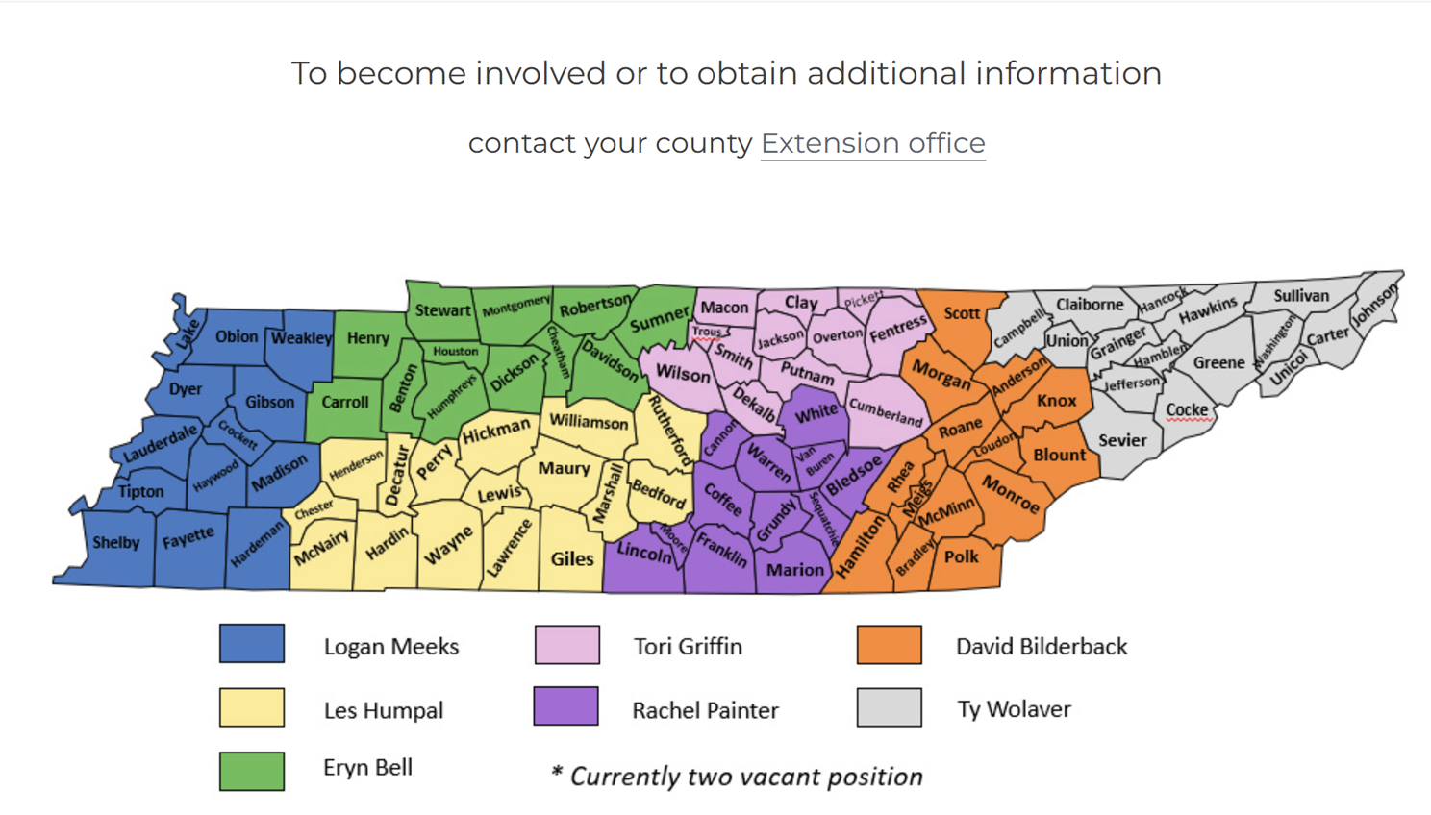
manage.tennessee.edu
Notes:
Here is a map of our farm management specialist territories. We are all here to serve and happy to help you. You can also contact your county agent to contact us as well.

Slide 5


Developing a Farm
Business Plan
Scan the QR code or visit this link for a copy of the slides
tiny.utk.edu/planpresentation
Notes:
Let’s begin our topic for today, which is developing a farm business plan. These slides are available online at tiny.utk.edu/planpresentation if you would like to revisit them or access them in a different format.

Slide 6
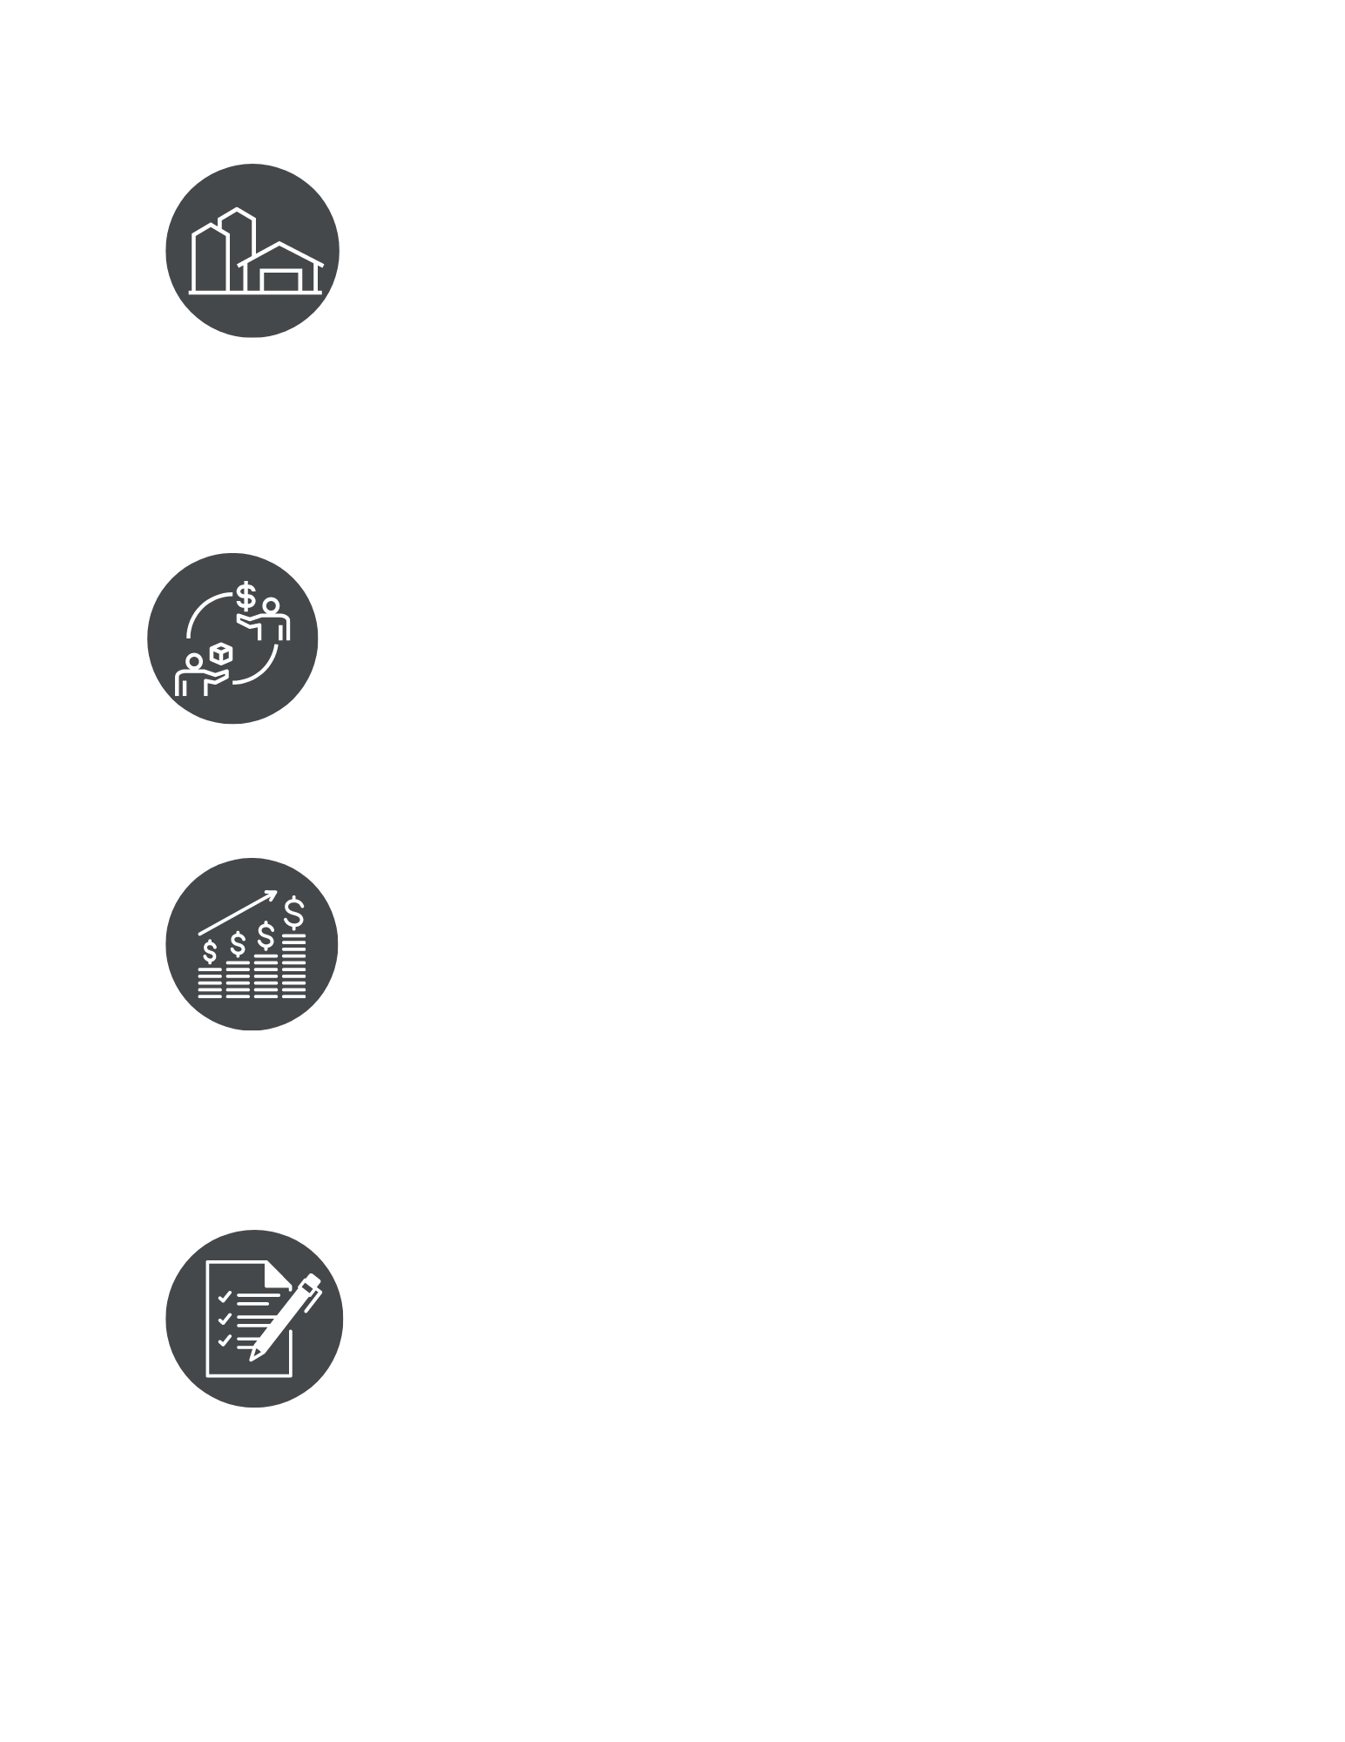
Developing a Business Plan
Defines and summarizes how resources and financing will be used to reach financial, marketing and operational goals
These documents are not stagnant
  continually changing and evolving
Not just about financial projections.
  Considers all aspects of the business
Executive Summary
Business Description
Marketing Plan
Financial Plan
Notes:
A business plan is a written document that is continually changing and evolving over time and as anything about your operation changes. The business plan defines and summarizes how you plan to utilize resources you have and any financing you may need to reach your financial, marketing, and operational goals.
A basic business plan has four main sections, the executive summary, business description, marketing plan, and financial plan.

Slide 7
Business Plan: 3 Versions
In Depth
Detailed
Longest Version
You Refer to
All the Details/Visions
Turn In
3-5 Pages
Concise
No Fluff
Only What is Needed
Lenders/Grants
Elevator Speech
1 Page Overview
Executive Summary
Pitch
Notes:
When writing a business plan, you want to use it as an opportunity to write a version that helps you plan for the future and document any important information about the farm and business decisions to look back on in the future. Your business plan that is just for yourself and any other owners to access should be detailed enough that if someone had to pick it up and start running your business in your absence, they have all the important information that they would need to do so.
After writing that version for yourself, you would plan to update that around every year or so and anytime anything major changed about the operation.
You would take that longer version and edit it down any time you need to turn in a business plan or parts of a business plan for any purpose, whether that be a funding program through the state or federal government, or for a lender. This condensed version would ideally be that 3 – 5 page range or maybe even less, depending on the guidelines of what they are looking for.
You may want to provide any decision makers or even investors or heirs with an updated one page overview each year, providing updates on mainly the executive summary of current goals or financial health of the business in a short summary.

Slide 8
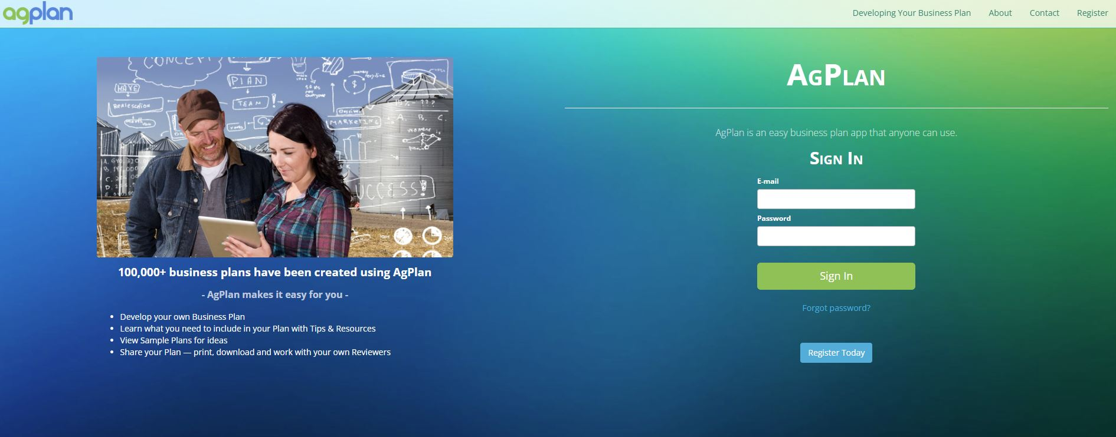
Notes:
There are many ways to write your business plan. Agplan is a great free, online option.

Slide 9
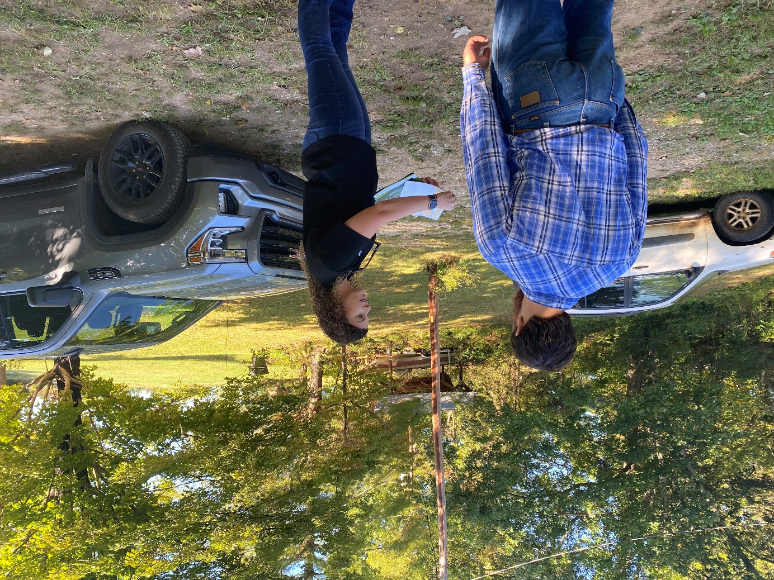
AGPlan
Free resource developed by the University of Minnesota
Online platform
Main website: agplan.umn.edu
Create as many plans as you would like
Share with reviewers who can view, edit, or comment
Provides tips, resources, and samples for each part of a business plan
Add attachments as needed
Notes:
AgPlan is offered by the University of Minnesota and only you can access your business plan in the online platform unless you choose to share it with others to review or edit with you. There are samples and tips in the platform to help guide you along as well. Many producers I work with will share their business plan with me so that they can have me review it and offer feedback online after we have initially met to begin discussing their plans and goals.

Slide 10
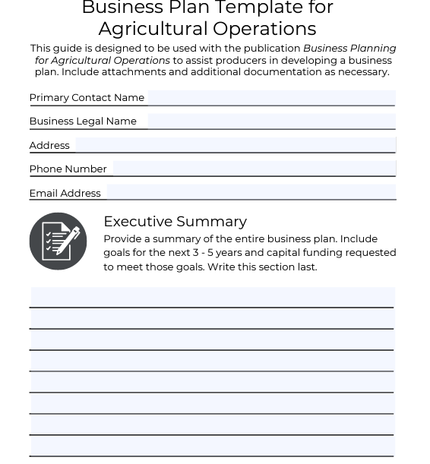
Developing a Farm Business Plan
Template/Executive Summary D179A
Business Description D197B
Marketing Plan D197C
Financial Plan D197D
Find this publication series at
tiny.utk.edu/farmbusinessplan
Notes:
We also have a series of publications our team developed to assist you with writing a basic business plan. The template at the back of publication A in this series, Developing a Farm Business Plan, is meant to be used as a place to think about and write down the main points you should include in each section as you get started.
You can access these publications at the link here on the screen, tiny.utk.edu/farmbusinessplan.

Slide 11
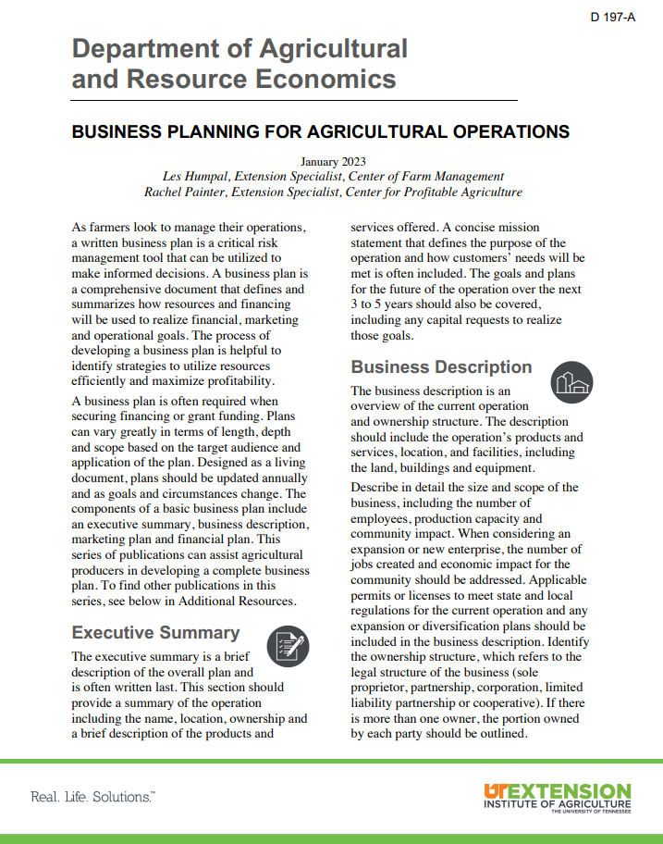
Executive Summary
Business Description
Marketing Plan
Financial Plan
Notes:
As we go through this presentation and through the publication series, you will notice these icons in the bottom left corner of the presentation and throughout the publication. These icons help you know which section you are writing and how to keep these sections organized in your mind and in your written business plan. Use these icons if you feel lost and refer back to them if you need to.
The first part of your business plan will be your executive summary, which just means a summary of the rest of the business plan.

Slide 12
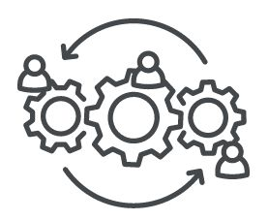
Executive Summary
The first piece, but last written part of your plan
Most important because this may be all that is read
Brief description of the overall plan that includes:
  Name
  Location
  Ownership
  Description of products and services offered
  Concise mission statement
  Goals and plans for the next 3-5 years
  Capital requests
Notes:
Since it is a summary of the rest of the business plan, you will write this section last. This will be extremely important as it should have all of the most important details included in it and again, could be provided to anyone with stock or financial ownership of the farm – from a partner or heir to a lender.
This executive summary should include some main contact information, including the name of the business and owners, the location, and description of products or services offered. Then, a concise mission statement or value statement, followed by major goals and plans for the next 3 – 5 years and any capital requests if you have those or the funds needed to reach those goals.

Slide 13
Executive Summary
How you will monitor certain production/financial measures?
  Recordkeeping System or Plan
Business transition plan
  Who will succeed after you?
  How/when will you make that transition?
Lease agreements
Big ownership changes, enterprise changes, business size changes, new production methods, new markets targeted
Notes:
If you are looking to borrow money, you may need to include this information in your executive summary as well to show that you are able to take on this responsibility and explain any issues that the lender or business partner may have – such as how you will show with records that you are meeting benchmarks or monitoring the success of the project. If the recipient is older or not in good health, then the lender or funder may ask about a transition plan or who will take over the liability or project if something were to happen to you.
If the operation relies heavily on lease agreements or any contracts for profitability and sustainability, they may ask for copies of written lease agreements.
You may also need to explain if any major changes have recently taken place or will take place within the business in the executive summary to again ease concerns and provide that explanation upfront so they don’t have to sift through the rest of the business plan.

Slide 14
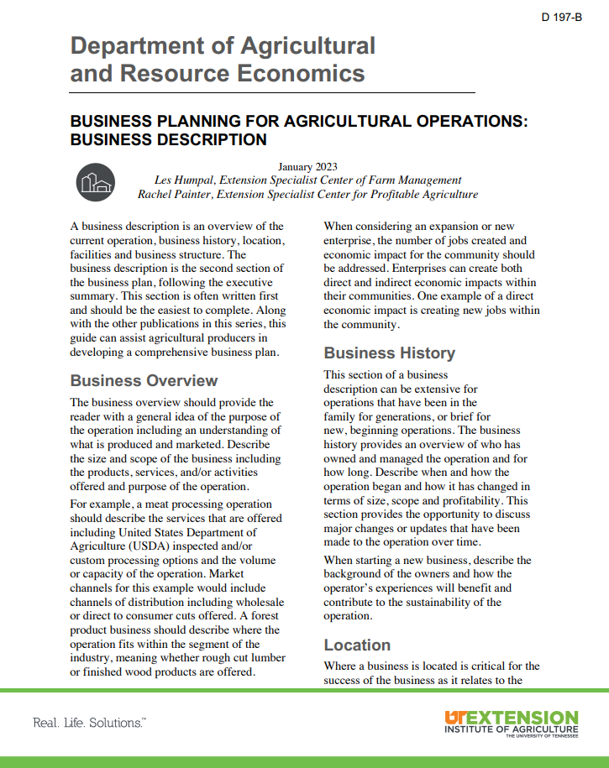
Executive Summary
Business Description
Marketing Plan
Financial Plan
Notes:
The first section of the business plan you will write is the Business Description.

Slide 15
Business Description
Second part of your business plan,
but written first
Overview of the current operation and ownership structure
Resources available and resources needed
Business Overview
Business History
Location
Facilities
Business Structure
Notes:
The second section of your business plan, but the part that you will write first is your business description. This should also be the easiest part of the plan as it is simply describing your business.
The business description will include the business overview, history, location, facilities, and business structure.

Slide 16
Business Description:
Business Overview
Purpose of your operation
Products or services
Size and scope of your business
Economic impact within the community
  How does your business better the community around you?
Business Overview
Business History
Location
Facilities
Business Structure
Notes:
You will begin with the business overview, which is just what you currently do on your operation and the ownership structure – for example, Dennis Farm is a 140 acre cow-calf operation in Coffee County, Tennessee owned by Joe and Wanda Dennis. If you are applying for funding related to economic impact or the supply chain, you may also want to include any kind of economic impact such as the number of employees the farm has and if you sell direct to consumer or provide inputs for another farm business in the local area that those businesses in turn rely on you to be able to run their operations as well. If you are going to be providing job opportunities or if you would be providing a product consumers wouldn't normally have access to in your area with funding, then you would want to outline that importance and community impact here, and of course be sure to include that in your executive summary later as well.

Slide 17
Business Description:
Business History
Who has owned and managed the operation and for how long
How the business started
Changes over time (size, scope, and profitability)
If starting a new business, describe the background of the owners and how that experience will be an asset to the operation
Business Overview
Business History
Location
Facilities
Business Structure
Notes:
Next is your business history. You will want to provide some information on how the business started, such as Dennis Farm began operation as a dairy farm in 1876 with Joe’s family. Since then, the family has passed down the farm and changed to a cow-calf operation and sold the dairy cows in 1982. Since Joe took over in 1985, the farm increased in size by purchasing an adjoining 28 acres to increase road frontage for the farm and provide a separate access point to move and check the cows.
If this is a new operation, you would want to include the background or knowledge of the owners and how they plan to use their expertise to be profitable.

Slide 18
Business Description:
Location
Physical location
Where products/services are provided
  How does the consumer access your product?
  Ex. Farmers markets, pick up sites, retail stores, online orders etc.
The cost and ease of transportation
  Sourcing inputs
  Supplying products/services to the consumer
Business Overview
Business History
Location
Facilities
Business Structure
Notes:
Next in your business description is your location. The location should include the actual address and addresses of any land parcels for the operation, as well as any locations where products are sold. We want to think about where do I take or transport my products to be sold. The location section of your business description can be used as a strategic point in the future if the market should change and any selling locations are changed to explain why the operation itself changed. Meaning, if a grain elevator opened up or closed nearby, that could really impact the business decisions on the operation.

Slide 19
Business Description:
Facilities
Provide an overview of:
  Land
  Buildings
  Equipment
  Details will include size, type and quality/condition
Discuss additional equipment or infrastructure needs you have to reach specific goals
  Describe the investment required to obtain these items
Include all permits and licenses utilized to meet state and local regulation
Include expansion plans
Business Overview
Business History
Location
Facilities
Business Structure
Notes:
Next is facilities. We want to provide a list or overview of any infrastructure on the farm, from buildings or large equipment. We also want to include the year they were built or any type of upgrades that have happened or need to happen, or the condition they are in.
If you are seeking funding for facilities or infrastructure, describe that here and how it would impact or change the farm from an operational standpoint.

Slide 20
Business Description:
Business Structure
Identify the legal structure of your business
  sole proprietor, partnership, corporation, LLC, etc.?
If there is more than one owner, write out how the business is split
Speak with an attorney or a CPA (certified public accountant) to choose what entity best fits your needs
If employees are utilized, provide a list of roles, responsibilities, and the managerial structure used
Business Overview
Business History
Location
Facilities
Business Structure
Notes:
Here is where you want to outline your current business structure, operational structure and who makes decisions. Again, if anything changes to that, you would want to come update this section of the business plan.

Slide 21
Business Description:
Other Considerations
Describe the resources you are working with
  Human capital, financial capital, connections, equipment, etc.
Include back up plans
  What will you use if your tractor breaks down?
  Who will pick up the slack if an employee is out of work for a while?
  What happens in emergencies – drought or extreme heat?
  What happens if you are dealing with issues such as pest management?
Include your production process
  Value-added item
  How is it produced, what is the output level, and what does the schedule look like?
Differentiation: What makes your item different than everyone else's?
Describe your production quality control plan
Describe any environmental stewardship plans
Discuss any regulation/licensing barriers
Notes:
Here is just a long list of other considerations that may or may not apply to you.
Again, these considerations would likely be in the version that is just for you and other owners to write together, but it would be a good idea to include any of this information or other information that would be important to know should something happen to you. If you are the only one to know how you decide to apply a fungicide every spring and who you typically purchase that from or who advises you on crop insurance decisions and how to contact them, or if you sell apple pies and you are the only one to know the recipe, then this is where you would to include that in your business plan

Slide 22
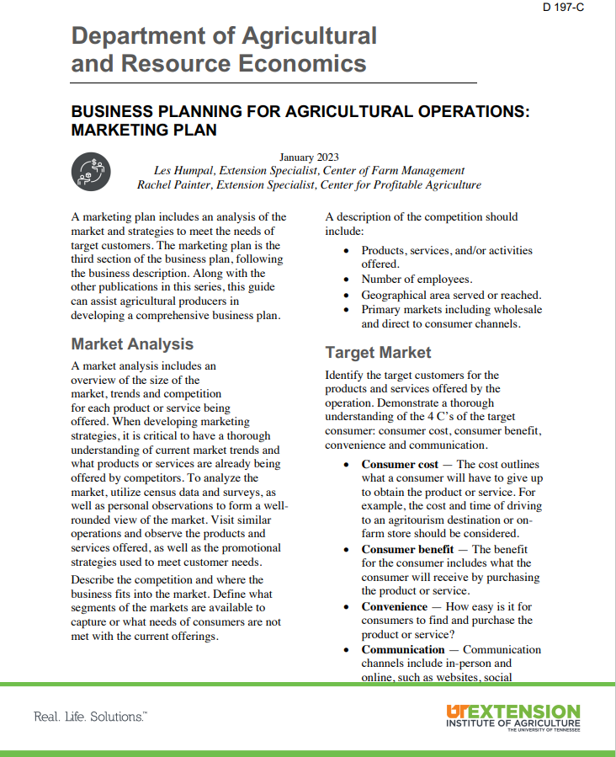
Executive Summary
Business Description
Marketing Plan
Financial Plan
Notes:
The next major section of your business plan is your marketing plan.

Slide 23

Marketing Plan
Third part of your business plan, following the business description
Market Analysis
Target Market
Marketing Mix
Notes:
Within your marketing plan, you will have three main sections, the market analysis and an outline of your target market, or who you plan to target to sell your products and services to, and your marketing mix, or how you plan to market to your target market.

Slide 24
Marketing Plan:
Market Analysis
Overview of the Market:
  Current supply and demand for the product or services
  Trends within the market
  Competition
Competitor Analysis:
  Describe competition in detail:
    Products and services offered
    Location and area served
    Primary market channels and buyers (wholesale, direct to consumer, on-farm sales, etc.)
  Census Data
  Research Publications
  Association Data
  Surveys
  Observations
  Competitors
Notes:
A market analysis is simply you analyzing the market for your products and services, meaning giving an overview of current supply and demand and influences or trends impacting that supply and demand.
You would want to look at data from surveys or the census online for national and state level data, as well as reports and insight from associations you may be a part of. Do you see any market gaps you want to explore filling demand for or do you see the market trending towards lower prices and you want to diversify or extend or add value to your product to reach another level of the supply chain to gain more of the consumer dollar?
A major part of the marketing plan for just yourself and owners to analyze and discuss is going to be a competitor analysis.
Who are our main competitors and what are they doing? How do their production and marketing practices differ from yours? What decisions are they seeming to make this year, and has that changed since last year? We want to be aware of what our competitors are doing not because we necessarily want to copy them, but because what they are doing may be impacting our market if they are supplying the same product to the same person or buyer as we are.

Slide 25

Marketing Plan: Target Market
‘Everyone’ is not your target audience.
Narrow down who your customers are to effectively market your products and services.
Who is your target customer?
Notes:
After our market analysis, we want to describe our target market. Everyone is not our target customer. If we are selling grain, our target customer or buyer may be two different grain elevators in the area. If we are selling goats, we may have some individual buyers that we could segment into their preferences and target their preferences differently than the local sale barn where we take goats one Saturday a month. We aren’t describing every customer we have here, but segmenting the market into groups of buyers that have similar preferences and purchasing habits.

Slide 26
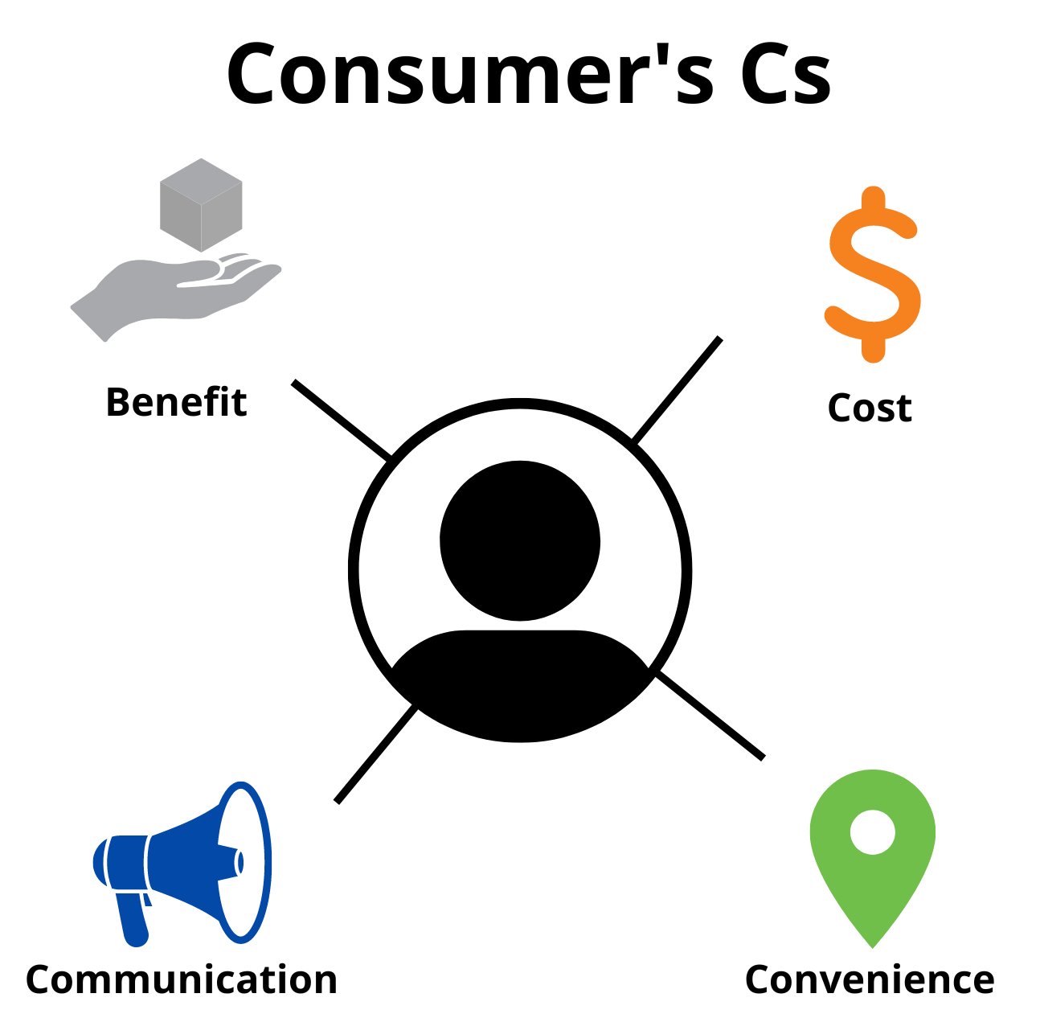
Marketing Plan
Notes:
In marketing, especially direct to consumer marketing, we concentrate on the consumer’s Cs – Consumer benefit, consumer cost, convenience, and communication.

Slide 27
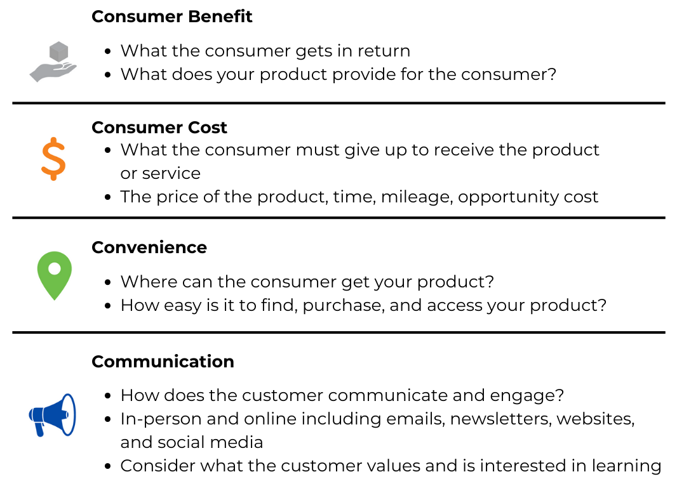
Marketing Plan: 4Cs
Notes:
We want to describe the benefit our customer gets from purchasing from us – what does your product provide intrinsically and extrinsically? They are getting the product itself but are there any characteristics such as production methods that set your product apart that they are getting from purchasing from you?
Consumer cost – what is their willingness to pay? Do you notice that certain customers are more price sensitive? If you increase the price, then they switch to buying from someone else, or are they loyal and always come back to you?
How convenient is purchasing from you for your customer? Do they have to come to you or are you delivering? Are you always easy to work with?
Communication – how does the customer or buyer want to communicate with you and what questions do they frequently ask? This is what they want to know and care about, so how can you make sure to communicate those details to them easily and often and using the platform or way that they like to communicate with you.

Slide 28
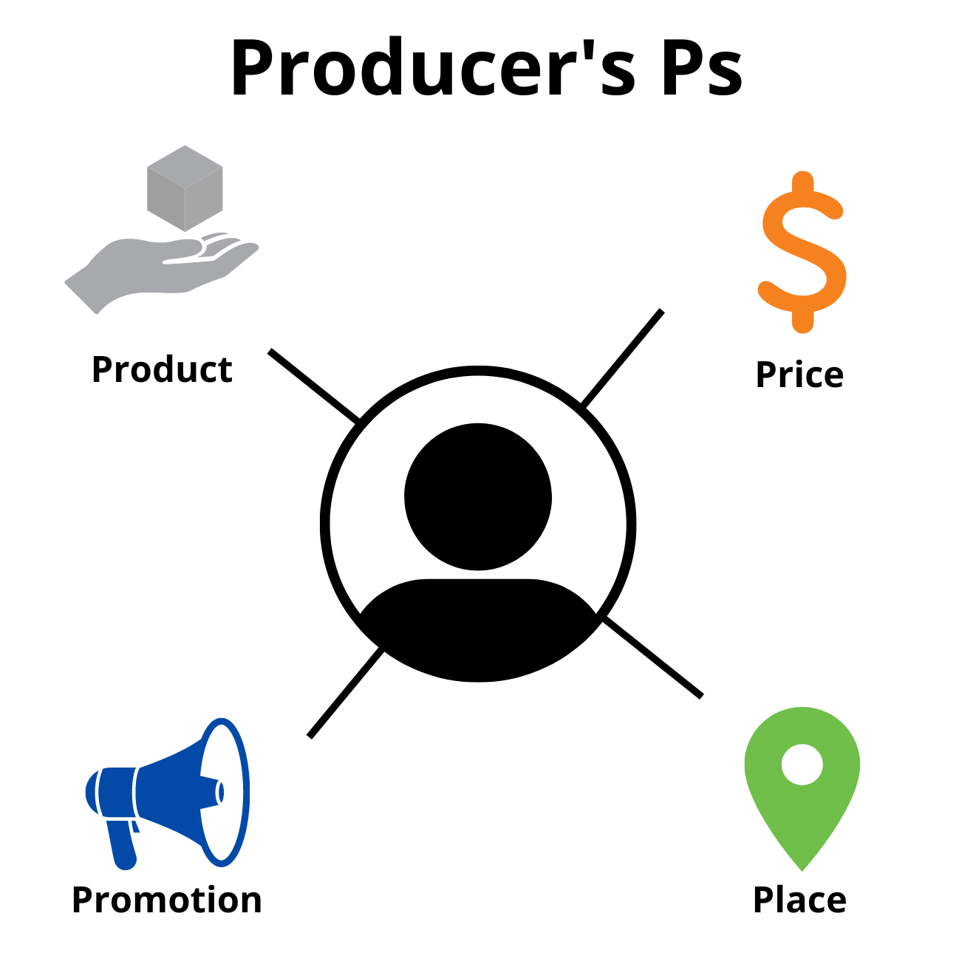
Marketing Plan
Notes:
We match those Consumer’s Cs up with the Producer’s Ps. Product, Price, Place, and Promotion. The Producer’s Ps are how you plan to meet consumer demand – or your marketing mix.
That is why these icons match up with those from the consumer’s Cs.

Slide 29
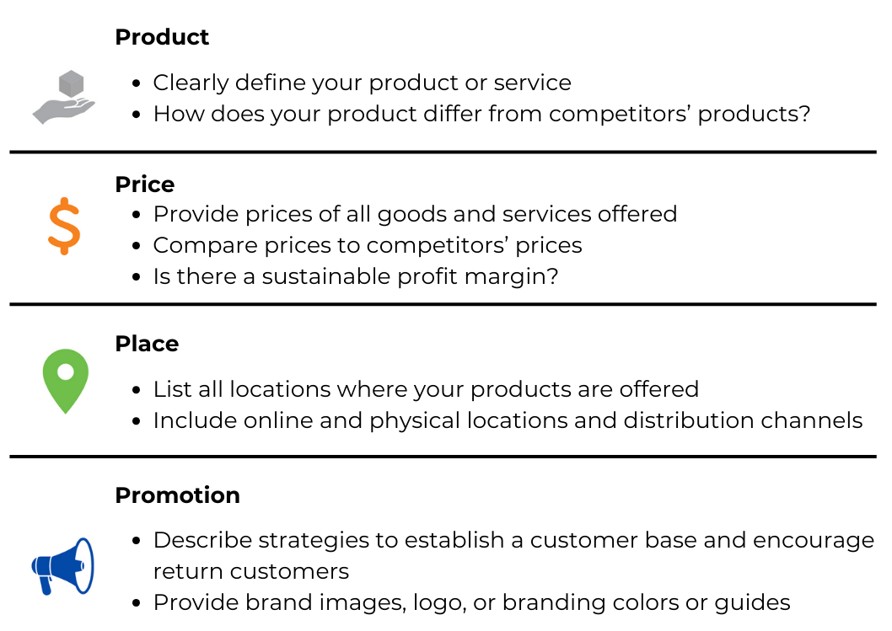
Marketing Plan: Marketing Mix
Notes:
To begin with Product, we want to describe the products and services we offer in detail. This can look like a product sheet that you offer if you are selling direct to consumer or it could look like a list of the products you plan to sell that year if you are selling commodities – an estimate of the number of bushels or the number of bulls you plan to sell that year if that was your product. If you differentiate your product somehow from other’s, you would want to describe that here.
Next, on price, again if we are selling direct to consumer we may have a longer list of products offered and we can just put the prices next to the products on a list. If we are selling a commodity and maybe there are even standards we are trying to reach to get a certain price, we would want to describe those standards or levels of moisture or quality to reach those various price points and which ones we plan to try to meet to get that price. In the version just for you, if you know your cost of production, you can describe the profit margin for that year here.
Place – again we want to list the places we sell our products – where do you deliver your grain to? Which farmers markets do you plan to sell at this year?
Promotion – we want to describe any promotional strategies we use to reach new customers and to encourage return customers to purchase again. So how are you again meeting the communication preferences and needs of your buyers so that they know about you and what you have to offer or what messages are you sending to buyers with your communication both verbal and nonverbal.

Slide 30
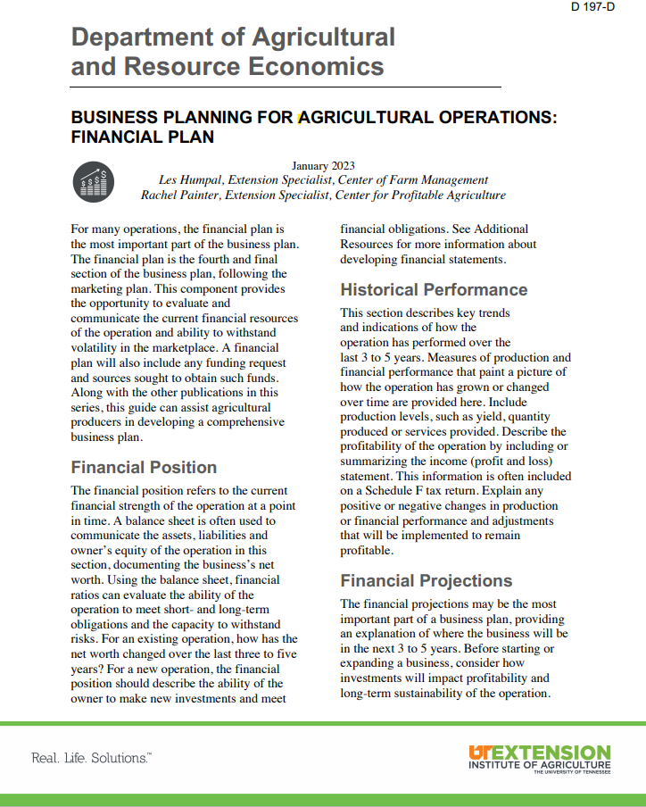
Executive Summary
Business Description
Marketing Plan
Financial Plan
Notes:
The next major section of your business plan is your financial plan.

Slide 31
Financial Plan
The final section of your business plan, following marketing plan
Typically considered the most important part of your plan
Show and evaluate the current financial resources of the operation
Funding requests
Financial Position
Historical Performance
Financial Projections
Capital Request
Notes:
In your financial plan, the components provide the opportunity to evaluate and communicate the current financial resources of the operation and ability to withstand volatility in the marketplace or take on risk. At the end of the financial plan, we will outline any funding requests or funding needs and how those would be used.

Slide 32
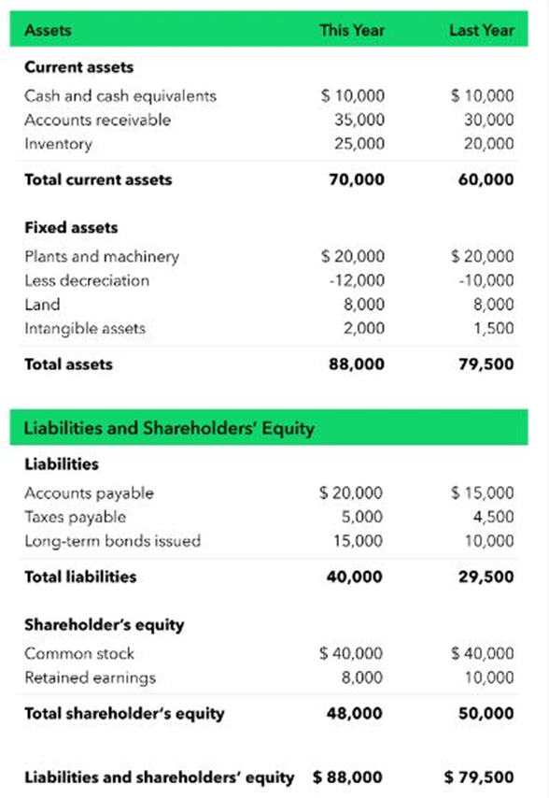
Financial Plan:
Financial Position
Current financial position your operation is in (stamp in time)
Utilize a balance sheet
  Assets
  Liabilities
  Owner’s equity
  Net worth
Evaluate the ability of your operation to meet obligations as well as handle risk
How has your net worth changed over time?
Can you make new investments?
Notes:
The first part of your financial plan is your financial position. This simply means what is the financial health of the operation right now, or at a stamp in time? You can use a balance sheet to evaluate and communicate this. The balance sheet would outline your assets, liabilities, owner’s equity, and net worth of the business. This can help you see if you are able to make new investments or purchases, and how much of the operation is owned by the owners versus the bank.

Slide 33
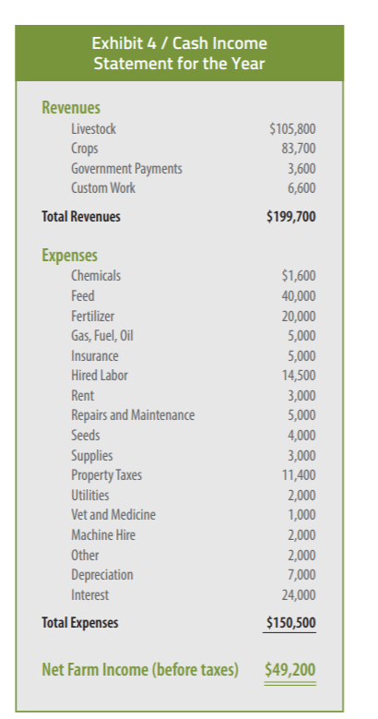
Financial Plan:
Historical Performance
Key trends in how the operation has performed over the last 3-5 years
Things to include:
  Production levels
  Yield
  Quantity Produced
  Profitability
Provide income statement (profit or loss)
  Many of the things you need can be found on a Schedule F
Notes:
After describing where you are at today, or your financial position, you want to look back in time to show your historical performance. So, using what you have today or your balance sheet, you can look back at balance sheets over the past 3 to 5 years to show a change, and you can also use an income statement to show your net farm income. This can help show how you have, hopefully, used the funds and resources you have wisely to paint a picture of financial stability.

Slide 34
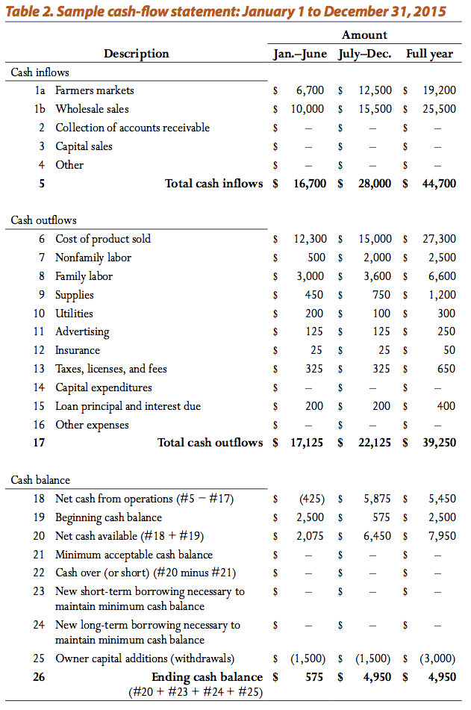
Financial Plan:
Financial Projections
Considered the most important part of the financial section
Describes where your business is headed financially (3-5 years)
Discuss business expansion
If investments are needed, how will they impact profitability and sustainability?
Provide a cash flow statement
  Show how projected income will exceed the expenses
Include how production and marketing scenarios will impact profitability
Discuss how the operation will withstand volatility/issues it may face
Notes:
Next we want to project how we are going to meet our goals in the future. To do so, we would make some financial projections. You can develop a cash flow statement for the next year to show expected income and expenses over the next year or two, or you can use a budget to project from a particular enterprise what the revenue would be.
We want to project how any investment would impact our financial health, meaning provide some financial ratios before the investment and then how those ratios would change after the investment.
We can also describe how the financial health of the farm would be impacted under various scenarios, such as volatility in prices or various impacts on yields and if we could still make payments under those scenarios.

Slide 35




Financial Plan: Financial Requests
Used if funding is being requested
Describe:
  How much is needed
  How the funds will be used
  Timeline of implementation
Show the sources you will seek for financial support, include the amount
Examples include: owner’s equity (personal investment), private lending, or grant funding programs
Notes:
Using the previous projections, you would want to outline exactly how much funding would be needed and what the funding would be used to purchase or do if a request is being made. We would want to clearly outline a list of the items to be purchased and a timeline for implementation for the project. When would it be up and running and able to start paying for itself? How long are the terms you are seeking on the funding? Where are you getting the funds from? If this is a cost share program, you may be required to have a financial letter from your bank or lender to show that you have the means to provide the capital to purchase the items and then get reimbursed the approved amount. This section should be to the point and clearly outline exactly what you are asking for.

Slide 36

Developing a Farm
Business Plan
Scan the QR code or visit this link for a copy of the slides
tiny.utk.edu/planpresentation
Scan the QR code or visit this link for
more information about the
Center of Farm Management
farmmanagement.tennessee.edu
Notes:
Again, after you have written the main sections of the business plan, you would go back and summarize that to form your Executive summary. We hope this outline of writing a business plan has been clear and you feel empowered to develop this tool for your farm and family.
Thank you for listening. Access these slides at tiny.utk.edu/planpresentation or visit our website at farmmanagement.Tennessee.edu for more information about what we do and how we can help you.

